Slide 1


The Past, Present, and Future of Security… and How to Stop It
Sounil Yu
@sounilyu
The measure of success is not whether you have a tough problem to deal with, but whether it is the same problem you had last year.
John Foster Dulles
We cannot solve our problems with the same thinking we used when we created them
Albert Einstein

Slide 2
A Quick History of IT and Security
1980s
1990s
2000s
2010s
Era
Core
Challenges
What did we buy and how does it support the biz?
Viruses, Server-side Attacks, Insecure Configs
Too many logs and alerts, Client-side attacks
Assume Breach, Raging Fires, Too Many Privileges
Asset Mgt, Systems Mgt Tools
Anti-Virus, Firewalls, Secure Configs
IDS, SIEM
Incident Responders & IR Tools (EDR, SOAR)
Solutions
SECURITY
(CISO)
IT / Security
Tension
STABILITY
(CIO)
Security Team
Composition
& Focus
None
Hobby Shop / Vulnerability Mgt
Sec Ops Center / Threat Mgt
Dedicated Biz
Unit / Risk Mgt
Notes:
In the 1980s, as information technology became affordable to the masses, enterprises started incorporating it into every facet of their business. One of the first challenges that we encountered in the 1980s is that of asset visibility and management, or being able to IDENTIFY our IT assets and classify them according to what they do and how critical they are to our business. Security was largely in the form of asset management programs. (Side note: Of course, we still struggle with asset management and asset visibility today, but as we adopt technologies that have management and visibility features built in, this becomes less of an issue. For security specifically, we should insist that all new technologies that we buy naturally provide high levels of visibility and telemetry without impacting performance of the underlying technology.)
In the 1990s, as we saw viruses and worms proliferate through our computers and networks, we introduced measures to PROTECT our IT assets. These measures manifested through secure configurations, antivirus software, and network firewalls. (Side note, when people say that it seems like someone’s security is stuck in the 1990s, this is why). Security organizations started as vulnerability management programs and policy shops where we started articulating what a securely configured system should look like. (Note that some security organizations debated whether or not business continuity was part of security. As we will see later in the fifth age, those organizations that saw business recovery as a part of security were prescient.) Note that this is when security and IT start heading into different directions with a tension between stable operations and security. Security, when bolted on, destablizes systems and creates potential disruptions (disrupts the running of technology)
In the 2000s, we saw that attackers were able to bypass antivirus, firewalls, and other protective controls and we needed a way to DETECT when that occurred. Thus was born technologies such as Intrusion Detection Systems and SIEMs that helped organizations trigger on unusual activities as detected in their logs. Security organizations shifted to include threat management programs and start building security operations centers staffed with personnel to continuously monitor and act upon alerts created by these detection systems.
In the 2010s (the current age), we realized that our detection systems were far from perfect, our analysts were overwhelmed by false positive alerts, and that we need to take an “assumed breach” mentality and RESPOND to incidents. In this current age, we see the emergence of incident response capabilities, which manifests largely as a capability delivered through people with some technology to assist. We also see the emergence of Hunt Teams that take an “assumed breach” mentality to seek out intrusions. Security organizations become more integrated into the overall risk management programs so that the wide range of security issues can be properly prioritized among competing demands for personnel and resources.

Slide 3
Mapping to the NIST Cybersecurity Framework
1980s
1990s
2000s
2010s
Era
IDENTIFY
PROTECT
DETECT
RESPOND
Core
Challenges
What did we buy and how does it support the biz?
Viruses, Server-side Attacks, Insecure Configs
Too many logs and alerts, Client-side attacks
Assume Breach, Raging Fires, Too Many Privileges
Asset Mgt, Systems Mgt Tools
Anti-Virus, Firewalls, Secure Configs
IDS, SIEM
Incident Responders & IR Tools (EDR, SOAR)
Solutions
SECURITY
(CISO)
IT / Security
Tension
STABILITY
(CIO)
Security Team
Composition
& Focus
None
Hobby Shop / Vulnerability Mgt
Sec Ops Center / Threat Mgt
Dedicated Biz
Unit / Risk Mgt

Slide 4



2020s: Age of Recovery (or Resiliency)
What kind of attacks should we see in the 2020s
that would challenge to our ability to RECOVER
or cause irreversible harm?
Confidentiality
Integrity
Availability
Ransomware
Notes:
So then the 2020s will be the age of recover, or as I would prefer to call it, it’s the age of resiliency.
But what might the RECOVER or RESILIENCY era look like? Or more specifically, what types of problems will we see in this era that will challenge our ability to recover?
If we map potential challenges against the traditional security paradigm of Confidentiality, Integrity, and Availability, then the types of attacks that we would see in the Age of Recovery are attacks that undermine our ability to recover from the loss of CIA.
I would propose that such challenges will manifest in the form of destructive or irreversible attacks that result in our inability to recover. Of course, we have already seen manifestations of this type of attack in the form of Wikileaks, Shamoon, and NotPetya. But these are all just the tip of the iceberg.
In the 2020s, we will see the full maturation of irreversible attacks that completely undermine our ability to recover.

Slide 5
2020s: Age of Recovery (or Resiliency)
What kind of solutions directly support
our ability to RECOVER or be RESILIENT?
Notes:
So if the problems facing us are irreversible and irrecoverable attacks, what solutions are security vendors offering?

Slide 6

Forging ahead or regressing back?
Recent advertising campaign from major vendor
A call to go back to the 1990s?
How will prevention mitigate the impact of ransomware?
  Remember, we learned “assume breach” in the 2010s
  Prevention minimizes the occurrences, but does not address the impact or ability to recover
1980
Identify
1990
Protect
2010
Respond
2000
Detect
2020
Recover
JOIN THE PREVENTION AGE
STOP CYBER BREACHES
Notes:
If I went to the security marketplace today and told vendors, “I’m concerned about ransomware. I need something that directly addresses my underlying challenge with ransomware,” the following advertising campaign is representative of what we will typically get.
Basically, this ad is saying that I should go join the Prevention Age?!?
But the Prevention Age is the 1990s! Is this a call to go back to past solutions for tomorrow's problems? In each era, we faced new challenges that directly undermined our ability to IDENTIFY, PROTECT, DETECT, or RESPOND. We had to develop new solutions to help overcome each of these new challenges. The prior era's solutions did not solve the current era's problems.
Ransomware is a new type of challenge that directly undermines our ability to RECOVER. But what you get from security vendors is just more PROTECT, DETECT, and RESPOND!
How will more old-era solutions of PROTECT, DETECT, and RESPOND address a new-era attack against our ability to RECOVER? The old-era capabilities may minimize the likelihood of occurrence, but they do not fundamentally address the impact from ransomware or the ability to RECOVER.

Slide 7


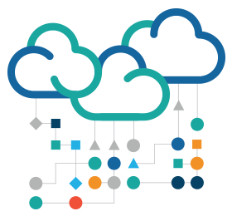

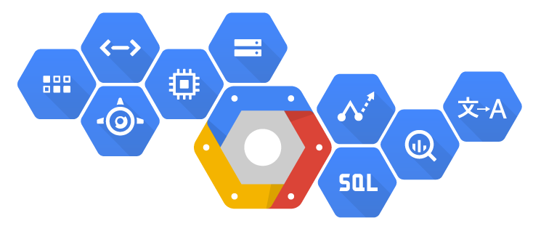
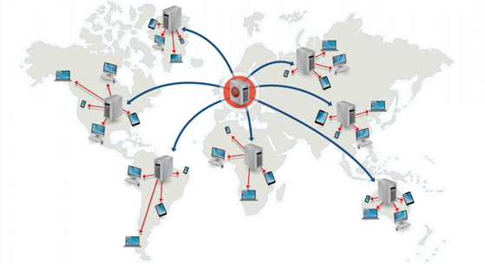
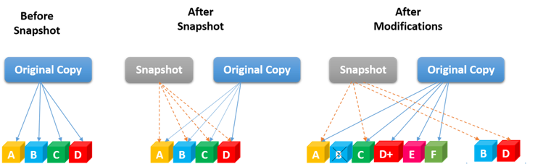

2020s: Age of Recovery (or Resiliency)
What kind of solutions directly support
our ability to RECOVER or be RESILIENT?
SERVERLESS ARCHITECTURE
Apps
Apps
Apps
Libraries
Hypervisor OS
Computer
Content Delivery Network
Copy on Write
Notes:
If we fully embrace the "assume breach" mentality that we adopted in the 2010s, then we must look for those solutions that truly help us RECOVER. If the solutions of the past are not fit for problems of the future, then what should we be looking for?
Well, as I looked for RECOVER-oriented solutions, I ended up with an interesting assortment of design patterns and capabilities, such as…
Content delivery networks
Design principles such as copy on write where you never erase anything, you just keep appending
New technological approaches such as Docker containers and serverless functions
Cloud infrastructure
Even buzzwords like blockchain
As I looked at all these different solutions that help us recover or be resilient, I found a certain pattern emerge.

Slide 8







The DIE Triad
Distributed
Immutable
Ephemeral
Distributed
Immutable
Ephemeral
DDoS
Resistant
The best solution against a distributed attack is a distributed service
Changes Easier to Detect and Reverse
Unauthorized changes stand out and can be reverted to known good
Drives Value of Assets Closer to Zero
Makes attacker persistence hard and reduces concern for assets at risk
Confidentiality
Integrity
Availability
Availability
Integrity
Confidentiality
Notes:
There are three core design principles that undergird these different solutions. Each exhibit some quality of being Distributed, Immutable, and/or Ephemeral. These three core design principles form what I call the DIE Triad.
But more than just helping with security, it turns out, these new patterns can eliminate the need for security at all.
If I have something that is highly distributed, why do I need to worry about a single system’s availability?
If I have something that is immutable, why do I need to worry about its integrity.
If I have something that is highly ephemeral, why do I need to worry about its confidentiality?
It turns out, if we design towards the new paradigms represented by the DIE Triad, we might not need to worry about the CIA triad.
In other words, if we can have our assets DIE, then do we need to CIA them?
Distribution: Problem of transaction routing through trustable "policy distribution" nodes to trusted "policy execution" nodes depending on policies from trusted "policy definition" nodes. | Immutability: the example of blockchain has its own consensus trust problems, but it is still better than other integrity perservation techniques. | Ephmeral: Supply chain trust, SBOM (software bill of materials) and trustable cloud provider software artefacts problems still exist.

Slide 9

The Alternative: An Endless Conveyor
Belt of Vulnerabilities and Threats
Distributed
Immutable
= x
Risk
Likelihood
Impact
Ephemeral
Never Ending Vulns
Confidentiality
Never Ending Threats
Integrity
Availability
Notes:
I think we should revisit some of our primary approaches for how we do security. For example, when we consider the traditional risk analysis equation, risk is often seen as a product of likelihood and impact.
Likelihood is made up of two factors: one is vulnerabilities and it seems that we see a never ending set of severe vulnerabilities You can be a completely patched today and tomorrow, you have yet another vulnerability that you need to patch. And if you don’t patch, it gets worse over time.
Likelihood is also made up of threats and our threat actors getting better in terms of their skill sets and remain pretty persistent at trying to break in.
Vulnerabilities age like milk while attacker skills age like wine.
The combination of the two means that likelihood is going to increase over time and unfortunately, this is largely out of our control.
However, what is under our control is impact. With likelihood going up, if we want to reduce risk, we need to focus on how we can dramatically reduce the impact in this risk analysis equation.
Well, the DIE Triad provides us a way to do this

Slide 10







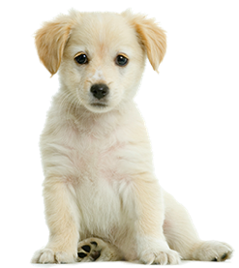
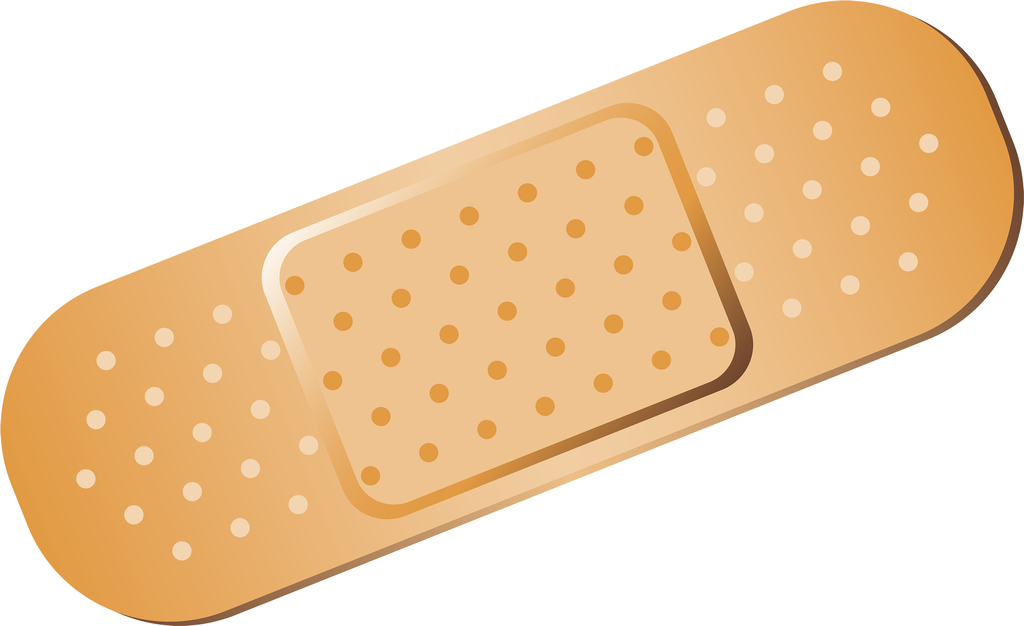


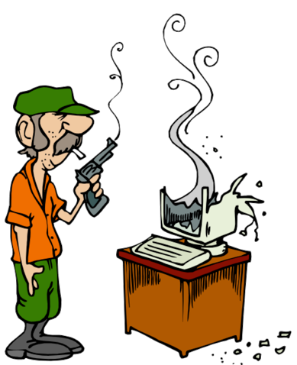
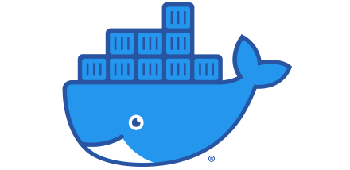

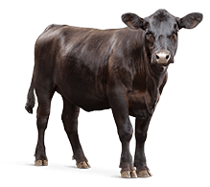

Pets vs Cattle
Given a familiar name
Taken to the vet when sick
Hugged
C.I.A.
Confidentiality
Integrity
Availability
Branded with an obscure, unpronounceable name
Culled from herd
D.I.E.
Distributed
Immutable
Ephemeral
Notes:
And to explain, I’ll use an analogy that I think many cloud native practitioners already embrace. It's the notion of pets and cattle. If you’re not familiar with it, let me explain.
Pets are things that you give a name. If they get sick, you take it to the vet. And you like giving it hugs. When we think about how we used to build systems before the cloud, we built a lot of pets. Our machines had names that we can pronounce, and when it had a vulnerability or a problem, we took it to our cyber vets to patch it and make it better. We liked hugging our machines. Things like our personal laptops and national ID numbers are pets.
Cattle on the other hand, you brand it with an obscure unpronounceable string of characters, and when it gets sick you cull it from the herd and you move on. Containers, lambda functions, and credit card numbers that continuously change are like cattle.
When it comes to our pets, we have to CIA. But when it comes to cattle, we should design them to DIE.

Slide 11
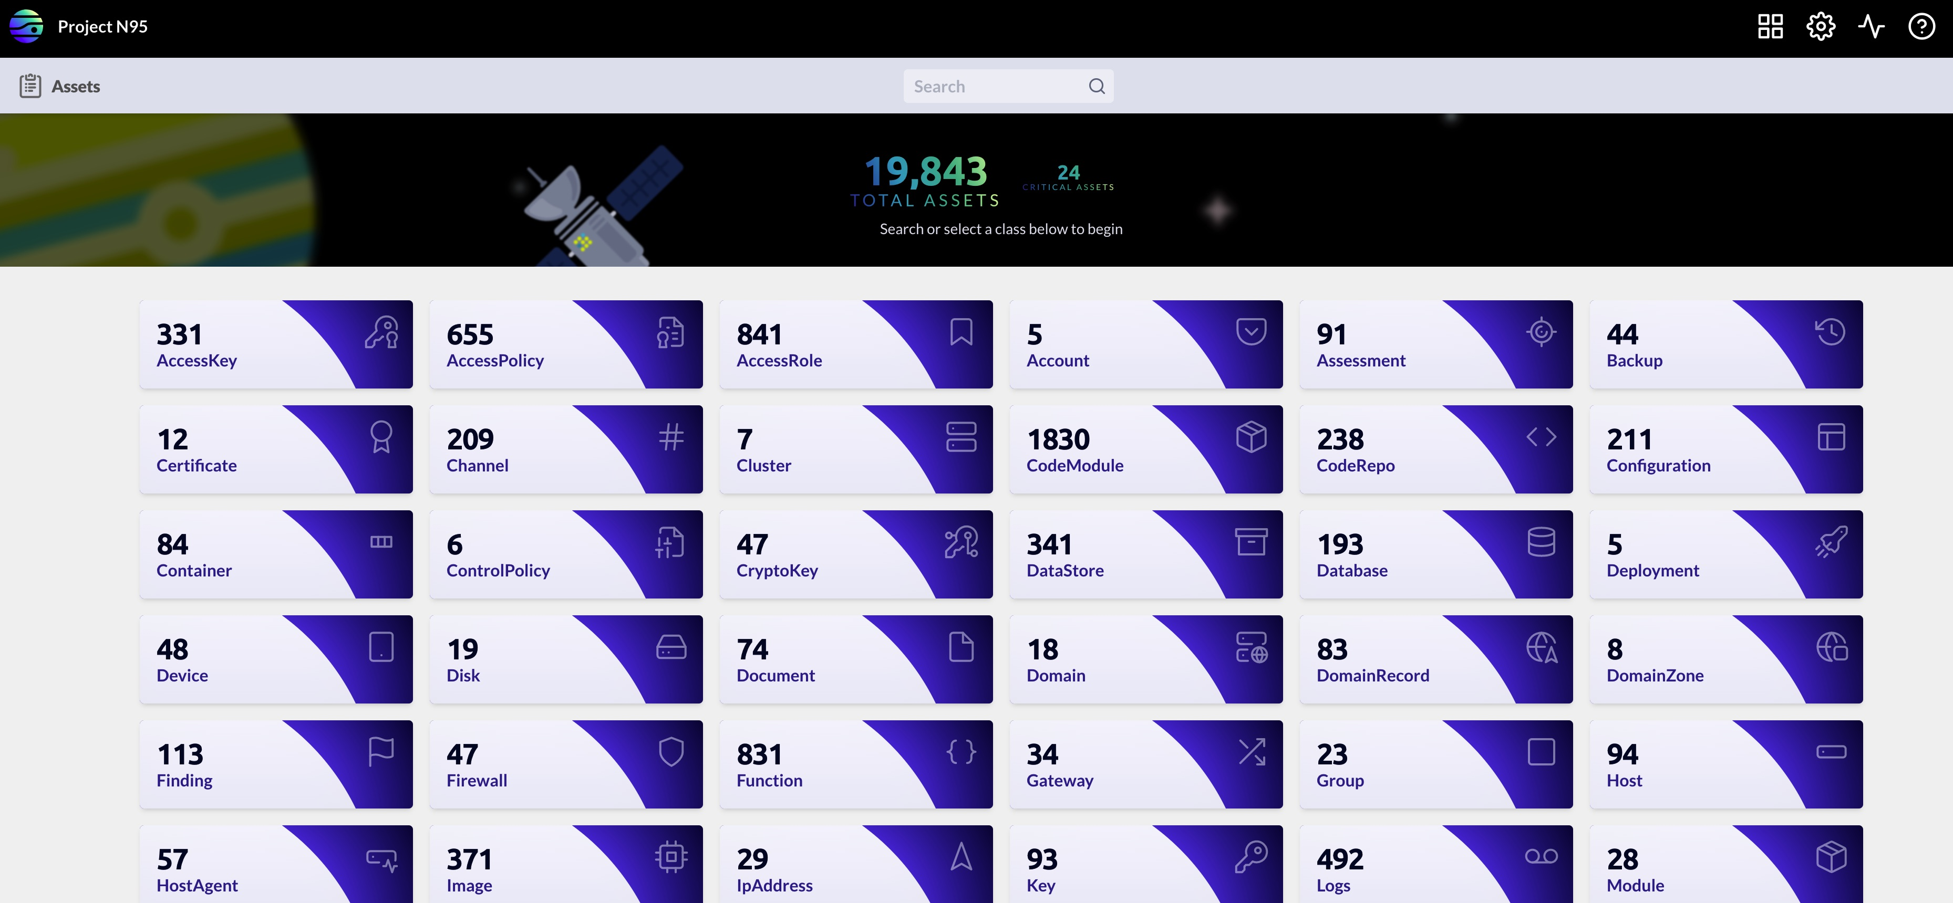
Which of these are pets? Which are cattle?
Source: Project N95 (https://projectn95.org) via JupiterOne (https://jupiterone.com)
Notes:
Now, how do we know what are our pets and what are our cattle? Is there an easy way to distinguish them?
Here’s an asset inventory for a group that I volunteer with called Project N95. Using a tool called JupiterOne, we can see that we have nearly 20000 assets of varying types. But which of these are pets? Which are cattle?
Typically, most of us manually tag assets as being critical and here, we’ve noted 24 being deemed critical. But are they really pets? And are these the only pets that we have here? Are there potentially more pets?

Slide 12
Measuring Resiliency: Pets vs Cattle Curve
10000
1000
Find design patterns, policies, and incentives that push the curve in these directions
ILLUSTRATIVE
Fewer
pets
Uptime (in Days)
100
Shorter-
lived
cattle
10
1
10000
15000
20000
1
5000
Pets
Asset
Cattle
Notes:
As I tried to answer this question, I found that it was helpful to look for measurements that align with the principles of the DIE Triad. For example, let’s take ephemerality. If the goal is to make things more short-lived, then perhaps we can measure how long lived something is. It turns out, this type of data is pretty widely available because most organizations that have a CIO have a Key Performance Indicator that is based on uptime.
So let’s suppose I can now get the uptime of every system or component that I have running. I’ll end up with a graph similar to this.
Now let’s suppose I set an arbitrary uptime threshold, meaning anything older than that uptime is a pet. Anything younger that threshold is cattle.
Having so many pets might not be desirable either. So now, I can set a goal to have fewer pets and shorter live cattle that moves this curve down and to the left.
By the way, I would argue that this curve is potentially a good representation of resiliency. Resiliency is an emergent property that is hard to measure directly. But I think you can get a good perspective of what is resilient by the shape of this curve.

Slide 13
More Ephemeral = More Resilient?
10000
1000
Find design patterns, policies, and incentives that push the curve in these directions
More
pets
Fewer
pets
Uptime (in Days)
100
Longer
lived
Shorter-
lived
cattle
10
1
10000
15000
20000
1
5000
Pets
Asset
Cattle
Notes:
Imagine two types of curves, one that looks like the letter L….

Slide 14
Less Ephemeral = Less Resilient?
10000
Longer
lived
1000
Find design patterns, policies, and incentives that push the curve in these directions
Fewer
pets
Avoid anti-patterns
that push the curve
in this direction
More
pets
Uptime (in Days)
100
Shorter-
lived
cattle
10
1
10000
15000
20000
1
5000
Pets
Asset
Cattle
Notes:
and one that looks like the number 7… I think it would be easy to argue that an organization with a Pets vs Cattle curve that looks like an “L” is going to be more resilient that an organization whose Pets vs Cattle curve looks like a 7.
As I mentioned earlier, we can’t measure resiliency directly, but I think that the shape of this curve is representative of how resilient a system might be.
But you can’t benchmark based on shapes. I needed a way to put some kind of number to this curve so that I can compare one shape with another. And that’s when I realized that this looks like a power law curve…

Slide 15
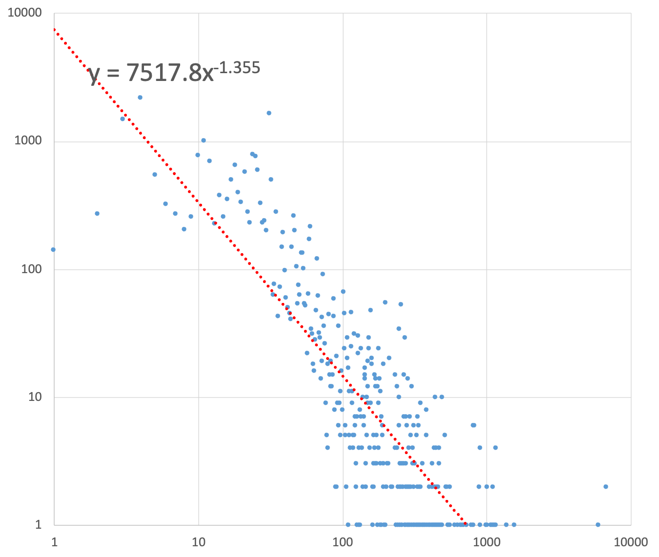
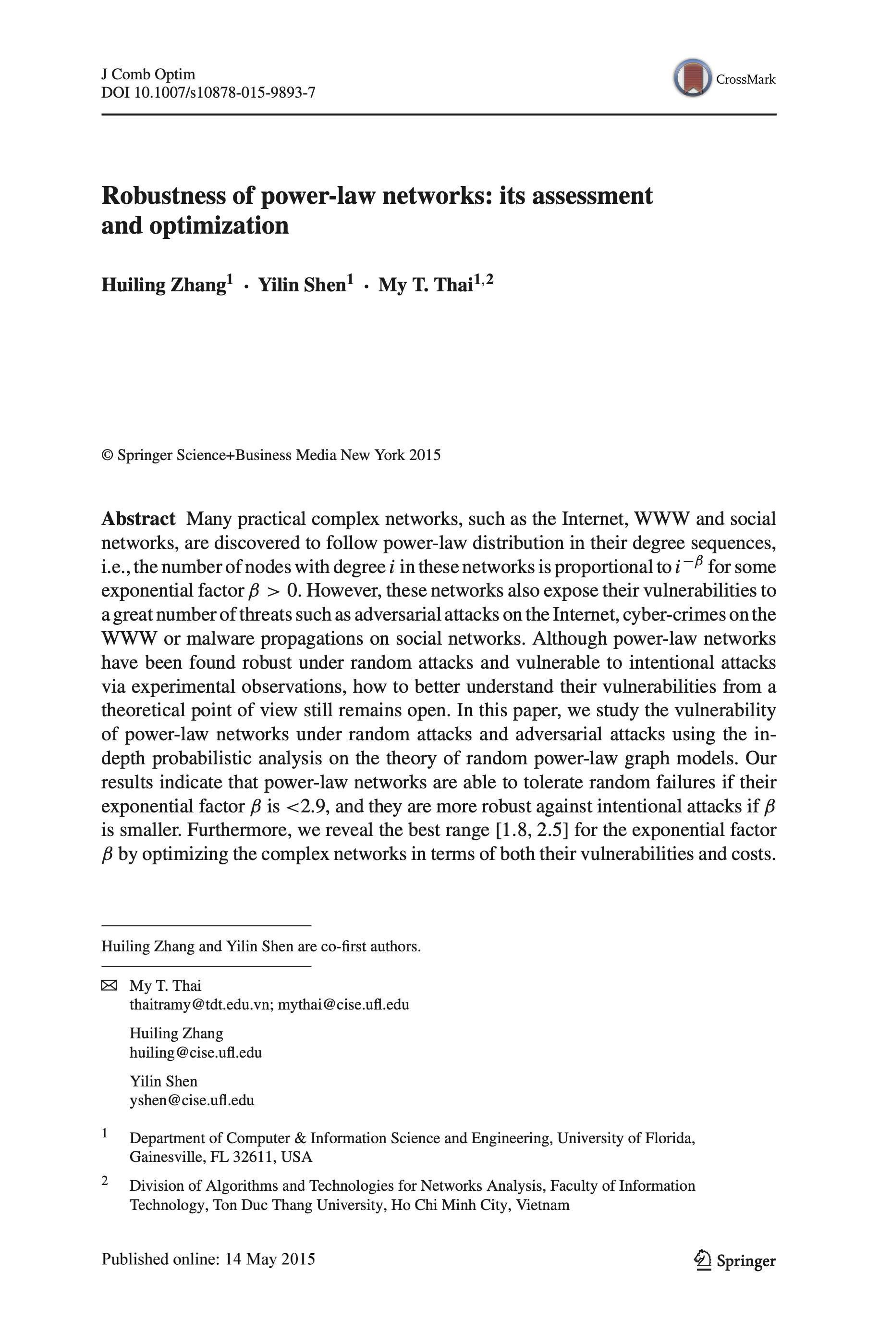
Benchmarking Resiliency
β = 1.355
If β is < 2.9 ➔ tolerates random failures
If β is smaller ➔ more robust against intentional attacks
(More short-lived cattle causes β to be smaller!!)
Best range is 1.8 < β < 2.5 when optimizing for both vulnerabilities and costs
  If β < 1.8 ➔ maintenance cost is very expensive
  If β > 2.5 ➔ robustness is unpredictable because it depends on the specific attacking strategy
# of Assets
Source: Huiling Zhang, Yilin Shen, and My T. Thai; Robustness of power-law networks: its assessment and optimization, 2015; https://www.cise.ufl.edu/~mythai/files/15joco.pdf
Uptime
Notes:
And so, using Excel, I put these values into a power law curve and it turns out that there’s an important value from the trendline equation that emerges from the resulting scatterplot. It’s the exponent that you see here, and for this curve, that value, also called beta, is about 1.4 for these data points.
Now when it comes to measuring robustness and resiliency, there’s a ton of research that has already been done on this. And here’s a paper that talks about the importance of this value in network topologies.
Basically, you want this number to be less than 2.9 for it to be fault tolerant. But more interestingly, the lower the beta value, the more resilient it is against intentional attacks. And guess what lowers the beta value. More shorter lived cattle!
However, there also appears to be a lower bound that is worth looking further into. I won’t go into the math here, but apparently, when I get to less than 1.8 for this beta, things start getting more expensive. There’s a mathematical reason for this when it comes to network connectivity, but I’m not sure if it applies to something like uptime. Perhaps there is a lower bound range that needs to be accounted for when it comes to uptime, but I'm not sure yet. Originally, I thought that having lots of cattle and as few pets as possible is preferred, and this research shows that is the case from a resiliency standpoint. But it may not be the most business efficient. I think it’ll require some additional research to discover whether these findings from network topologies apply when it comes to measuring resiliency based on ephemerality.

Slide 16
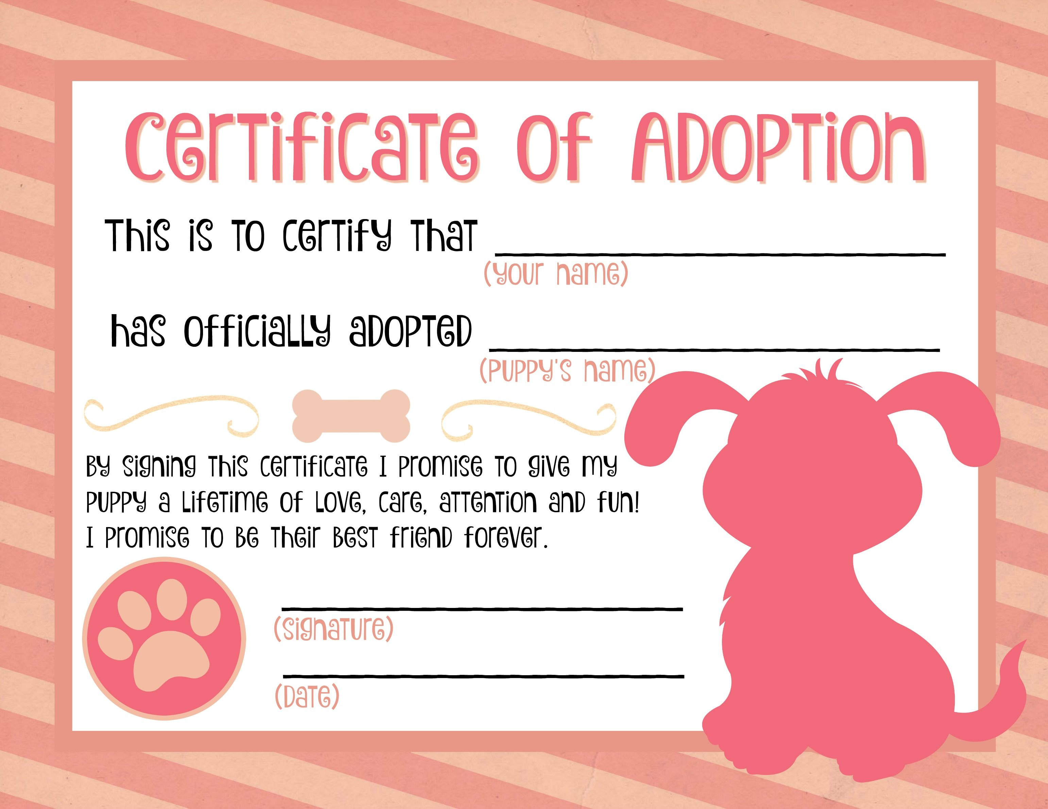
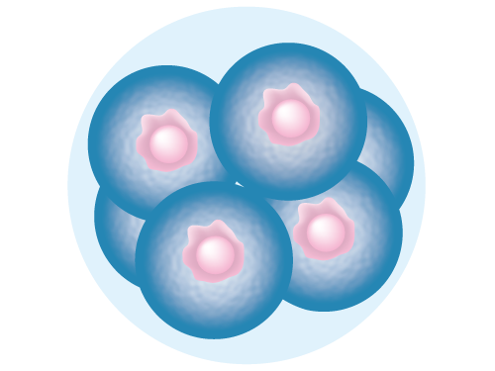

Pets vs Cattle Controls
Discourage / Disincentivize
decommissioning
creative destruction
rebooting/reimaging
privacy enhancing tech
modifying an immutable container
letting an asset live longer than needed
patching in place
Encourage / Incentivize

Slide 17
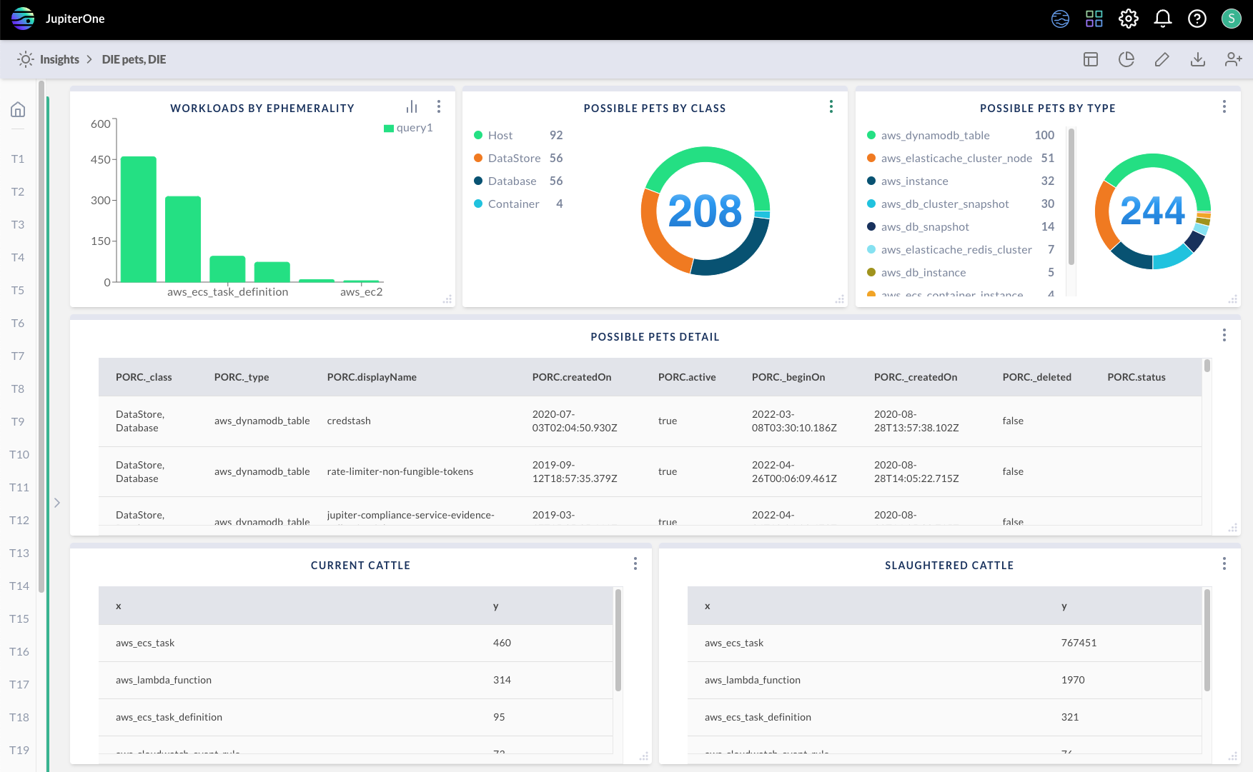
Pet Management at my $dayjob
My most valuable metric:

Slide 18
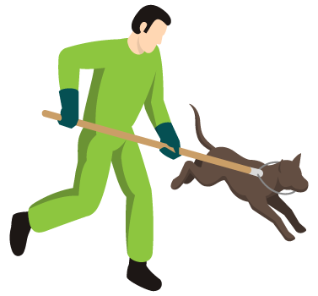
The DIE Triad Changes Roles & Responsibilities
Cyber
Veterinarians
Cyber
Pet Control Officer
Confidentiality
Distributed
Immutable
Integrity
Availability
Ephemeral
Notes:
When we have to deal with pets, our role is as a cyber veterinarian and taking care of pets requires lots of tender loving care through CIA centric controls.
But defending these indefensible pets is hard enough. This challenge is exacerbated by the sheer number of pets that we often have to deal with. If you’re a pet owner, I’m sure you are doing fine taking care of a few pets in your household. Imagine if you multiplied that by 10x and they started breeding among themselves. It would be figuratively and literally a zoo.
So we have to think about our role differently, specifically to avoid unknowingly creating new pets, and the operative term here is “unknowingly.” It’s fine if someone wants to create or adopt a new pet. They just have to sign up to the responsibility to care for that pet or at least provide the resources to ensure that it’s properly taken care of.
And so I think our role as security professionals will shift from strictly being a veterinarian to also becoming a pet control officer, ensuring that the organization does not end up adopting or breeding more pets than it can handle. And if we take the philosophy that we should prioritize DIE over CIA, then that means we our role as a cyber pet control officer should come before our role as a cyber veterinarian. In other words, we should first and foremost encourage the organization to minimize the number of pets. And then secondarily for the few pets that you do have, practice the best veterinary care that you can provide with the limited resources that you have.

Slide 19
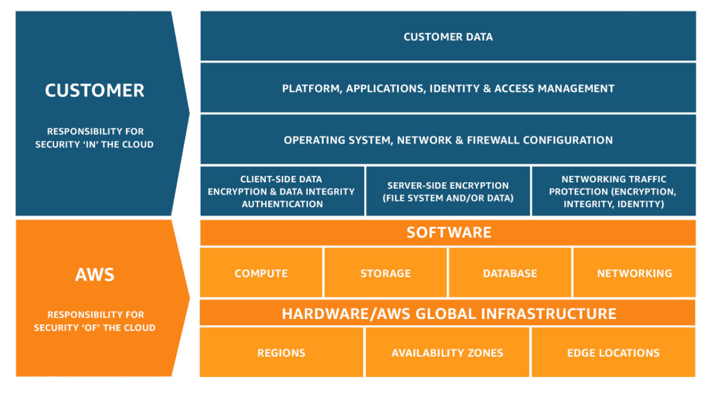
The distribution of “Pets” and “Cattle” changes across the Shared Responsibility Model
Confidentiality
Integrity
Availability
Distributed
Immutable
Ephemeral
Privacy
Enhancing
Tech
CWPP
CSPM
CNAPP
Distributed
Immutable
Ephemeral
Notes:
Now when it comes to cloud infrastructure, I found another interesting pattern with DIE. It seems that the distribution of pets and cattle shifts in ways that align with the Shared Responsibility Model.
AWS published this model to help customers understand that AWS will be responsible for security of the cloud, but customers are responsible for security in the cloud. Since AWS is responsible for security of the cloud, the underlying components that make up the cloud can be seen as “cattle” by AWS customers. Compute, storage, databases, networking, hardware, even whole regions and availability zones, at the macro level, they are all cattle. From the customer’s standpoint, they are disposable. They manifest the attributes of the DIE triad. However, as we move up to the part of the model where customers are responsible for security, we start seeing more pets.
Our goal should be to try to keep them like cattle.
---
Over time and with tools like CSPM and CWPP, we can start our journey towards higher levels of cloud native maturity so that we end up with more cattle in the cloud and for the pets that we do have in the cloud, they are actually secure. And over the longer term, we should continue to make design decisions that aim to have our environment in the cloud be all cattle. I don’t think we’ll ever get there because I think we’ll always have some pets, but such a goal helps us make better design choices while minimizing the burdens that we would otherwise face if we ended up with too many pets. I think that the proportion of pets that we find may reflect the maturity of an organization’s adoption the cloud, where fewer and fewer assets resemble pets and look instead more like cattle.
---
And I think it’s noteworthy that Customer Data sits at the top of this model. Customer data seems to resist being turned into cattle. But I don’t think that will forever be the case because there are a number of privacy enhancing technologies (which ironically enough has the acronym PET), that allow us to turn customer data from pets into cattle…

Slide 20

Applying DIE to Data: Privacy Enhancing Technologies
Data Minimization
Homomorphic Encryption
Secure Multiparty Computation
Blockchain
Tokenization
PII Vaults
Synthetic Data / Differential Privacy
Trusted Execution Environments
Secret Sharing
Federated Learning
Notes:
These tools include differential privacy, homomorphic encryption, multi-party computation, trusted execution environments, and federated learning. I think that’s the future of data security… making data more like cattle so that we don’t even need to protect it at all, and we can instead let it DIE.

Slide 21

Applying DIE to Data: Privacy Enhancing Technologies
DIE Triad Alignment
Distributed
Immutable
Immutable
Distributed
Ephemeral
Ephemeral
Data Minimization
Pet Control
PII Vaults
Pet Control
Secret Sharing
Distributed
Federated Learning
Distributed
Blockchain
Immutable
Homomorphic Encryption
Ephemeral
Tokenization
Ephemeral
Synthetic Data / Differential Privacy
Ephemeral
Trusted Execution Environments
Ephemeral
Secure Multiparty Computation
Ephemeral
Privacy By Design (DIE) is not the same as Security By Design (CIA)
Notes:
These privacy enhancing technologies are highly aligned to the DIE principles and enable us to treat data like cattle. Not implementing DIE for data will require us to have to CIA those data pets, and over time, they become a burden (and punishment) when data does not align with DIE.
Add secret sharing

Slide 22
The DIE Triad
Distributed
Immutable
Immutable
Distributed
Ephemeral
Ephemeral

Slide 23
Opposite Ends of the Spectrum?
Confidentiality
Integrity
Availability
Distributed
Immutable
Ephemeral
More Secure
More Resilient
Availability
Distributed
Integrity
Immutable
Confidentiality
Ephemeral
Notes:
There are three core design principles that undergird these different solutions. Each exhibit some quality of being Distributed, Immutable, and/or Ephemeral. These three core design principles form what I call the DIE Triad.
But more than just helping with security, it turns out, these new patterns can eliminate the need for security at all.
If I have something that is highly distributed, why do I need to worry about a single system’s availability?
If I have something that is immutable, why do I need to worry about its integrity.
If I have something that is highly ephemeral, why do I need to worry about its confidentiality?
It turns out, if we design towards the new paradigms represented by the DIE Triad, we might not need to worry about the CIA triad.
In other words, if we can have our assets DIE, then do we need to CIA them?
Distribution: Problem of transaction routing through trustable "policy distribution" nodes to trusted "policy execution" nodes depending on policies from trusted "policy definition" nodes. | Immutability: the example of blockchain has its own consensus trust problems, but it is still better than other integrity perservation techniques. | Ephmeral: Supply chain trust, SBOM (software bill of materials) and trustable cloud provider software artefacts problems still exist.

Slide 24
CIA By Design vs DIE By Design
Confidentiality
Integrity
Availability
Distributed
Immutable
Ephemeral
More Secure
More Resilient
Availability
Distributed
Integrity
Immutable
Confidentiality
Ephemeral
Notes:
There are three core design principles that undergird these different solutions. Each exhibit some quality of being Distributed, Immutable, and/or Ephemeral. These three core design principles form what I call the DIE Triad.
But more than just helping with security, it turns out, these new patterns can eliminate the need for security at all.
If I have something that is highly distributed, why do I need to worry about a single system’s availability?
If I have something that is immutable, why do I need to worry about its integrity.
If I have something that is highly ephemeral, why do I need to worry about its confidentiality?
It turns out, if we design towards the new paradigms represented by the DIE Triad, we might not need to worry about the CIA triad.
In other words, if we can have our assets DIE, then do we need to CIA them?
Distribution: Problem of transaction routing through trustable "policy distribution" nodes to trusted "policy execution" nodes depending on policies from trusted "policy definition" nodes. | Immutability: the example of blockchain has its own consensus trust problems, but it is still better than other integrity perservation techniques. | Ephmeral: Supply chain trust, SBOM (software bill of materials) and trustable cloud provider software artefacts problems still exist.

Slide 25
CIA By Design vs DIE By Design
Confidentiality
Integrity
Availability
Distributed
Immutable
Ephemeral
Availability
Distributed
Integrity
Immutable
Confidentiality
Ephemeral
Notes:
There are three core design principles that undergird these different solutions. Each exhibit some quality of being Distributed, Immutable, and/or Ephemeral. These three core design principles form what I call the DIE Triad.
But more than just helping with security, it turns out, these new patterns can eliminate the need for security at all.
If I have something that is highly distributed, why do I need to worry about a single system’s availability?
If I have something that is immutable, why do I need to worry about its integrity.
If I have something that is highly ephemeral, why do I need to worry about its confidentiality?
It turns out, if we design towards the new paradigms represented by the DIE Triad, we might not need to worry about the CIA triad.
In other words, if we can have our assets DIE, then do we need to CIA them?
Distribution: Problem of transaction routing through trustable "policy distribution" nodes to trusted "policy execution" nodes depending on policies from trusted "policy definition" nodes. | Immutability: the example of blockchain has its own consensus trust problems, but it is still better than other integrity perservation techniques. | Ephmeral: Supply chain trust, SBOM (software bill of materials) and trustable cloud provider software artefacts problems still exist.

Slide 26
CIA By Design vs DIE By Design
Confidentiality
Integrity
Availability
Distributed
Immutable
Ephemeral
Strong authentication
User-centric design
Logging/observability
Reduced hardening
Invariants (Immutable)
Secure by default
Notes:
There are three core design principles that undergird these different solutions. Each exhibit some quality of being Distributed, Immutable, and/or Ephemeral. These three core design principles form what I call the DIE Triad.
But more than just helping with security, it turns out, these new patterns can eliminate the need for security at all.
If I have something that is highly distributed, why do I need to worry about a single system’s availability?
If I have something that is immutable, why do I need to worry about its integrity.
If I have something that is highly ephemeral, why do I need to worry about its confidentiality?
It turns out, if we design towards the new paradigms represented by the DIE Triad, we might not need to worry about the CIA triad.
In other words, if we can have our assets DIE, then do we need to CIA them?
Distribution: Problem of transaction routing through trustable "policy distribution" nodes to trusted "policy execution" nodes depending on policies from trusted "policy definition" nodes. | Immutability: the example of blockchain has its own consensus trust problems, but it is still better than other integrity perservation techniques. | Ephmeral: Supply chain trust, SBOM (software bill of materials) and trustable cloud provider software artefacts problems still exist.

Slide 27
Examples
Confidentiality
Distributed
Immutable
Integrity
Availability
Ephemeral
F-16s
Water Treatment Plants
Nuclear Power Plants
Banks
Hospitals
Drones
Life Straws
Localized Solar Generation
Decentralized Finance
Telemedicine / Clinics on Wheels
Notes:
There are three core design principles that undergird these different solutions. Each exhibit some quality of being Distributed, Immutable, and/or Ephemeral. These three core design principles form what I call the DIE Triad.
But more than just helping with security, it turns out, these new patterns can eliminate the need for security at all.
If I have something that is highly distributed, why do I need to worry about a single system’s availability?
If I have something that is immutable, why do I need to worry about its integrity.
If I have something that is highly ephemeral, why do I need to worry about its confidentiality?
It turns out, if we design towards the new paradigms represented by the DIE Triad, we might not need to worry about the CIA triad.
In other words, if we can have our assets DIE, then do we need to CIA them?
Distribution: Problem of transaction routing through trustable "policy distribution" nodes to trusted "policy execution" nodes depending on policies from trusted "policy definition" nodes. | Immutability: the example of blockchain has its own consensus trust problems, but it is still better than other integrity perservation techniques. | Ephmeral: Supply chain trust, SBOM (software bill of materials) and trustable cloud provider software artefacts problems still exist.

Slide 28

DIE and the OODA Loop
Orient
Decide
Act
Observe
Defender OODA Loop
Observe
Decide
Act
Orient
Attacker OODA Loop
Act
Decide
Orient
Observe
Business OODA Loop
w/Traditional CIA Restrictions
Natural Business OODA Loop with DIE
DIE design patterns that allow businesses to move faster naturally shorten the OODA loop
(OODA_{Business} – OODA_{CIO+CISO} = Shadow IT)
Notes:
Now, DIE done properly, radically changes how the security team relates to the business, and the intersection between the DIE Triad and the OODA loop can help us understand why.
--
Traditionally, when it comes the relationship between defenders and attackers, the defenders often have an OODA loop that is longer than the attackers. That’s because the attackers usually have first mover advantage.
--
However, there is another entity that is able to move faster than the attacker, and that’s the Business.
--
Unfortunately, security layers on many CIA-oriented restrictions that result in the business OODA loop growing longer than the attackers.
--
In my view, DIE enables us to restore the business OODA loop to its natural speed. DIE design patterns enable us to shorten the OODA loop.
-
And by the way, I think that the presence of Shadow IT or Shadow SaaS is a reflection of the difference in the OODA loop speed between the business and the CIO and CISO. Where security is able to embrace DIE, we can increase the gap between the OODA loop of the business and the attacker, returning the advantage to the attacker.
-
And this is why I believe that Ryan McGeehan, who advises a lot of startups that generally build cattle in cloud native environments, says that large swaths of security risk is simply being eliminated because they are embracing DIE-like concepts.

Slide 29
The Future of Security… Completing the CSF
1980
Identify
1990
Protect
2010
Respond
2000
Detect
2020
Recover
Era
Core
Challenges
What did we buy and how does it support the biz?
Viruses, Server-side Attacks, Insecure Configs
Too many logs and alerts, Client-side attacks
Assume Breach, Raging Fires, Too Many Privileges
Ransomware, MBR Wiper, DDoS, Firmware Bricking
Asset Mgt, Systems Mgt Tools
Anti-Virus, Firewalls, Secure Configs
IDS, SIEM
Incident Responders & IR Tools (EDR, SOAR)
Distributed, Immutable, Ephemeral (DIE!!!) Systems
Solutions
SECURITY
(CISO)
A
IT / Security Tension
STABILITY
(CIO)
B
Security Team
Composition
& Focus
None
Hobby Shop / Vulnerability Mgt
Sec Ops Center /
Threat Mgt
Dedicated Biz
Unit / Risk Mgt
C
Choose Your
Own Destiny

Slide 30





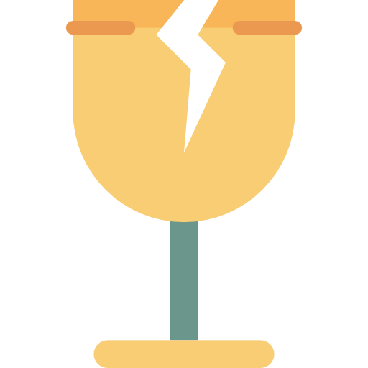

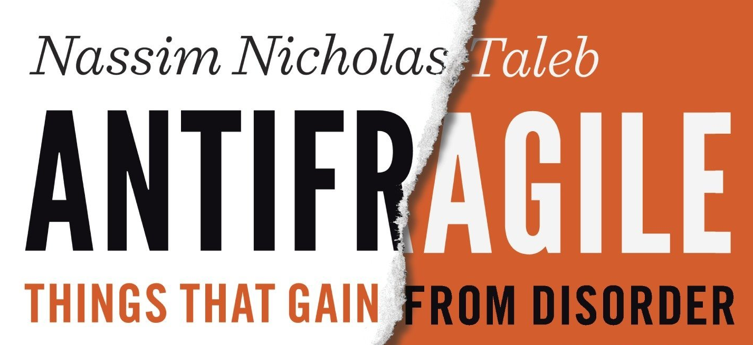
Fragility vs Resiliency vs Antifragility
Destiny A
Destiny B
Destiny C
RESILIENT
(D.I.E.)
D.I.E. + Chaos Engineering +
Creative Destruction
(C.I.A)
Harm mitigated through bolt-ons and workarounds that create instability
Harm results in destruction but
no change in configuration
Harm finds unknown pets and removes them to make system even more DIE-like
Chaos Engineering Redefined:
Intentional discovery of unknown
pets that exacerbate fragility
Creative Destruction Redefined:
Intentional removal of known
pets that exacerbate fragility
Notes:
Creative destruction can be seen as decommissioning of known pets. Chaos engineering can be seen as discovering unknown pets.

Slide 31
Death to CIA! Long live DIE!
Thank you!

