Slide 1
High-Risk, High-Reward: Securing Your Organization in the Multi-Cloud Era
Matthew Hains

Slide 2


About Me
6+ years of cybersecurity cloud experience in major enterprises
AWS, GCP, and Azure experience
AWS Solutions Architect, GCP ACE, CCSP certifications
400+ cloud migration/assessments
Avid skier and hiker
Lives in an oven (Phoenix, AZ)
Matthew Hains,
Cloud & Container Security Architect

Slide 3
1.
What is Multi-Cloud?
2.
Everything is Fine…
3.
Developers are Innovators
TABLE
OF CONTENTS
4.
Security vs Freedom
5.
Security at Scale
6.
Contextualization at Scale
7.
Putting it all Together
8.
Q&A

Slide 4
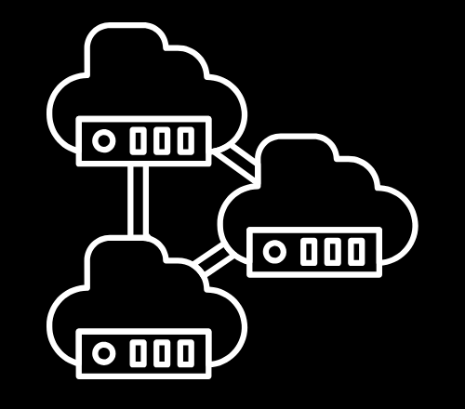
What is
Multi-Cloud?
Notes:
What is multi-cloud
Let’s walk though how we get there
”What if we move to the cloud”
Year 1:
Show diagram with 1 cloud account, 1 pipeline, 1 a few services
Show developer count

Slide 5
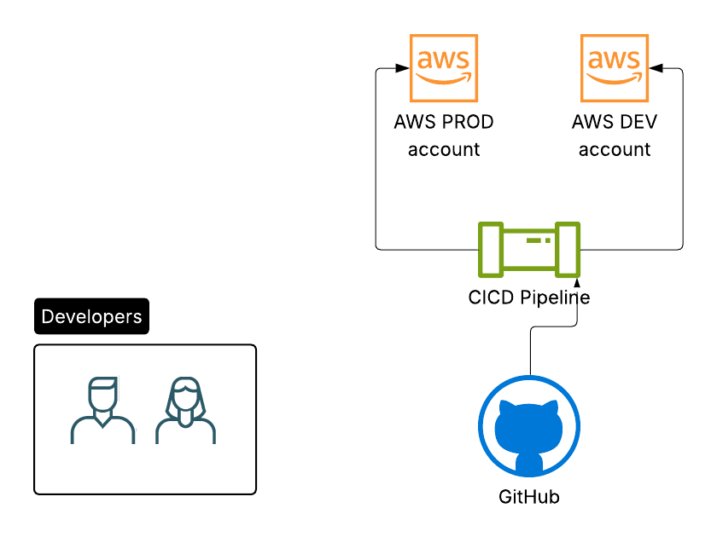
What is Multi-Cloud?
Let’s start with an example…
“What if we moved into the cloud?”
Year 1:
  1 cloud provider
  2 cloud accounts
  A handful of developers
  30 cloud resources
  4 roles
Notes:
What is multi-cloud
Let’s walk though how we get there
”What if we move to the cloud”
Year 1:
Show diagram with 1 cloud account, 1 pipeline, 1 a few services
Show developer count

Slide 6
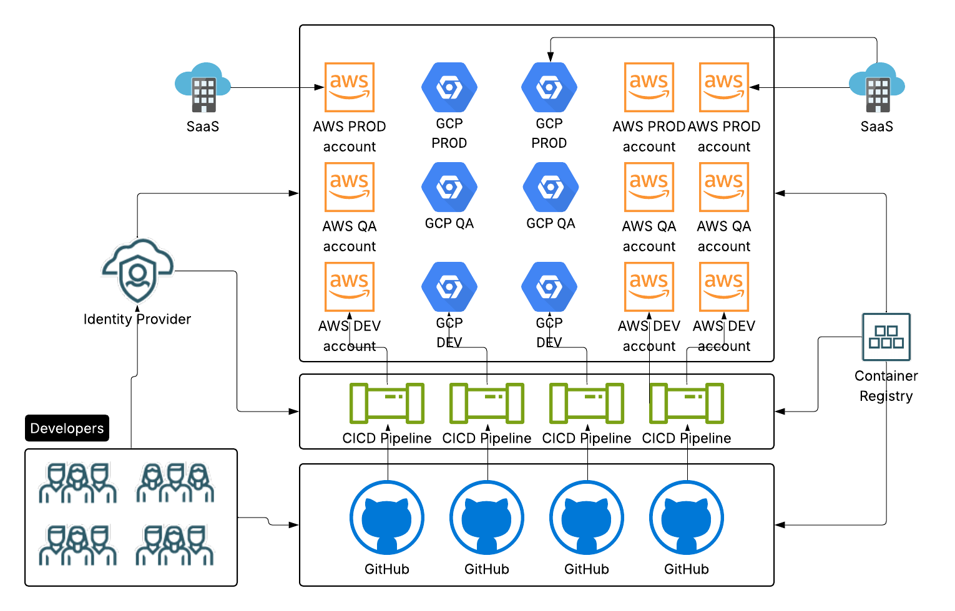
What is Multi-Cloud?
Let’s start with an example…
“We didn’t consider…”
Year 3:
  2 cloud providers
  15 cloud accounts
  Two SaaS
  15 developers
  300 cloud resources
  25 roles
Notes:
What is multi-cloud
Let’s walk though how we get there
”What if we move to the cloud”
Year 3:
Show diagram with 3 cloud account, 2 pipeline, many services, add in GCP
Show developer count

Slide 7
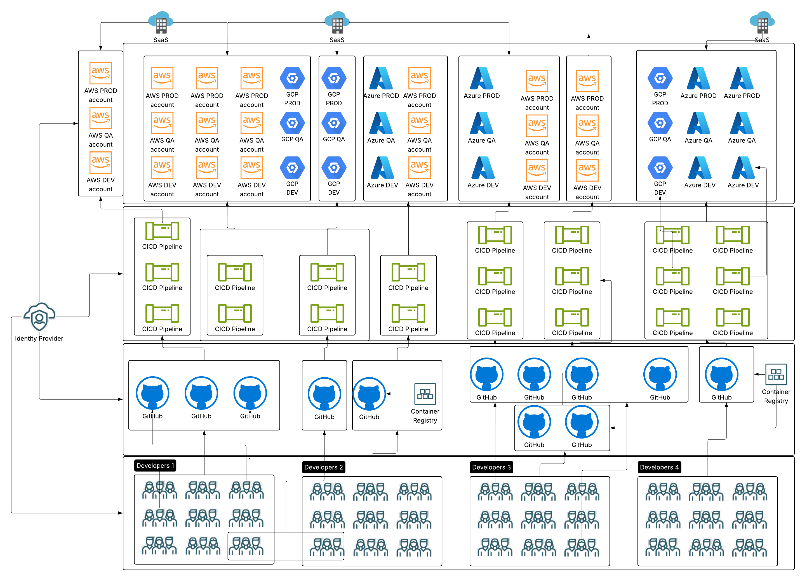
What is Multi-Cloud?
Let’s start with an example…
“One more thing…”
Year 5:
  3 cloud providers
  50+ cloud accounts
  Many SaaS
  100+ developers
  2000 cloud resources
  55 roles
Notes:
What is multi-cloud
Let’s walk through how we get there
”What if we move to the cloud”
Year 5:
Show diagram with 10 cloud account, multi pipeline, many services, add in GCP – Azure , SAAS
Show developer count

Slide 8
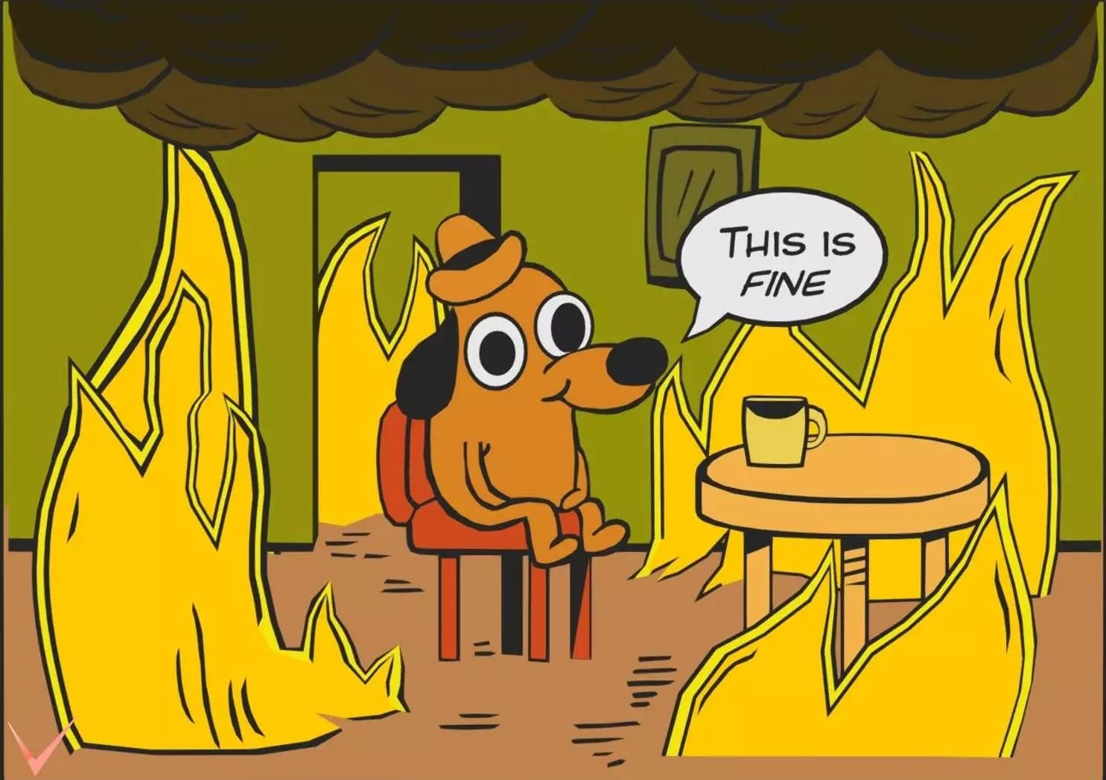
Some Industry Statistics
Palo Alto Networks Unit 42 Cloud Threat Report (2023)
  “The average large organization operates across five or more cloud accounts/providers and often has over 500 individual cloud accounts or projects within a single provider, especially in AWS or Azure.
Gartner (2023)
  “By 2025, 75% of large enterprises will have more than 1000 distinct cloud instances (projects, subscriptions, or accounts) spanning multiple providers.”
Flexera 2024 State of the Cloud Report
  Enterprises (companies with 1,000+ employees) use an average of 2.3 public clouds and 3.3 private clouds—and larger enterprises often manage hundreds to thousands of individual cloud accounts, subscriptions, or projects across AWS, Azure, and GCP.
Notes:
Photo of everything on fire
What is multicloud in practice
Problem statement and why does this happen?

Slide 9
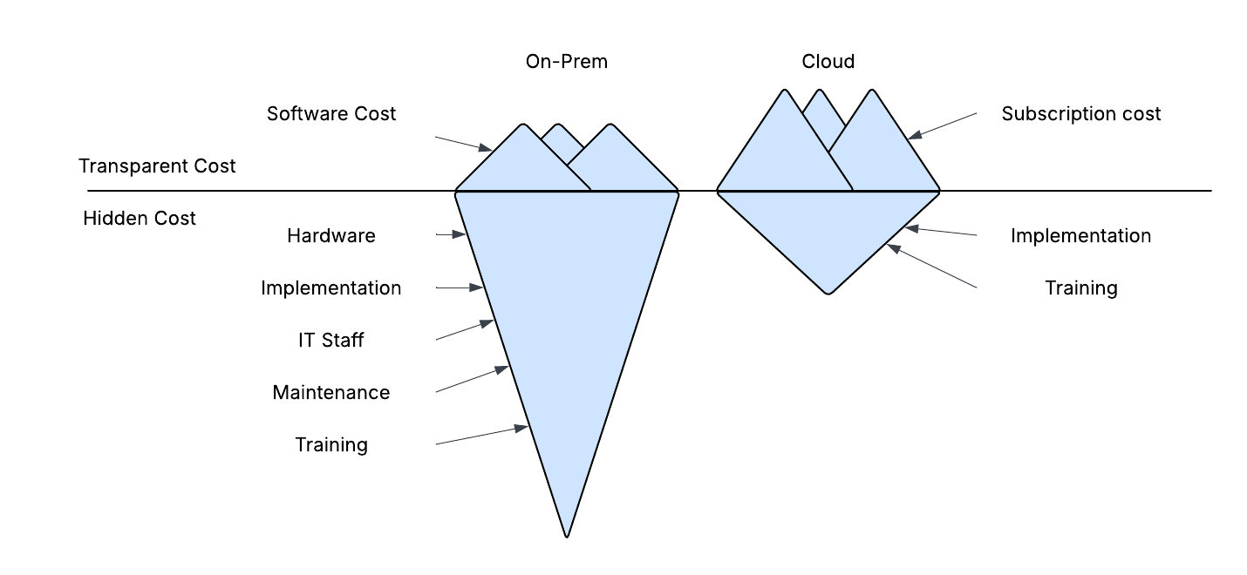
Everything is Fine…?
What does Multi-Cloud mean in practice?
  Multiple uses of cloud infrastructure across many vendors or providers
  Heavy cost savings to traditional infrastructure
  Efficient building and removal of resources
  Constantly growing tech stack services to choose from
The Bottom Line
  IDC and AWS estimate a 30 to 50% cost savings and a 60% IT productivity increase moving to the cloud
  AWS states over 3 years companies on average save 3.6 million in infrastructure and 1.5 million in avoided downtime costs
Notes:
Photo of everything on fire
What is multicloud in practice
Multi architecture
Several cloud dependent resources
Siloed processes
High external management

Slide 10

Developers
Are the Innovators

Slide 11
Developers are the Innovators
  “75% of enterprises credit their development teams as the primary force behind accelerating multi-cloud adoption, through building microservices, containerization, and CI/CD pipelines.”
  IDC & Google Cloud, Unlocking Business Acceleration with Cloud-Native Development (2022)
Why does the cloud work?
Engineers/developers trained specifically to use this technology.
The Cloud is very tool-agnostic.
Developers can bring their own unique history to the platform
  “81% of enterprises report that developer-driven cloud initiatives (such as self-service environments and infrastructure-as-code) are crucial to scaling multi-cloud environments.”
  Flexera, State of the Cloud 2024
  “Organizations that empower developers with cloud-native tools see a 3× higher rate of innovation and faster deployment cycles.”
  Puppet, State of DevOps Report 2023

Slide 12


Developers are the Innovators
Two Developers’ Stories
Joey
  10 years of cloud experience
  50/50 AWS and Azure
  Uses Python
  Specializes in databases
  Uses many SaaS solutions
Lindsey
  10 years of cloud experience
  Mostly AWS and some GCP
  Uses Ruby
  Specializes in IAM roles & Kubernetes
  Prefers home grown tooling
Developers with the same years of experience on paper may have largely different preferences and specialties.

Slide 13

The Crossroads of Freedom vs Security
Striking a Balance
Return on Security Investment (ROSI) in Cybersecurity
How do we allow the innovators in the cloud to bring their unique talents to the platform while also making sure we keep security at the forefront?
As the enterprise grows, so does the number of resources and the need to protect them

Slide 14
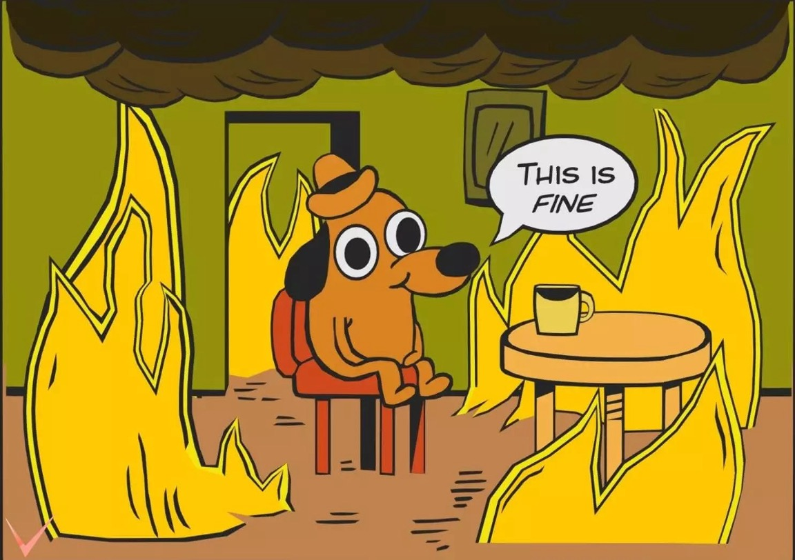





Freedom vs Security
A Security Perspective
  The total cloud usage is going to grow as the organization does
  Developers are going to innovate with cloud adoption
  Developer preferences are going to expand the resource usage
  Security is going to need to adapt and be ever-present
Notes:
Photo of everything on fire
What is multicloud in practice
Multi architecture
Several cloud dependent resources
Siloed processes
High external management

Slide 15
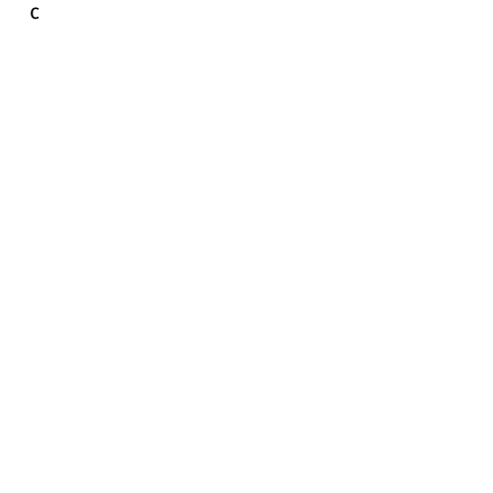
Security
at scale

Slide 16
Security at Scale – Where do we start?
Goals
What we should not focus on
  Securing lambda functions
  Solving single provider problems
  Deep-dive security into single applications
What we should focus on
  Multi-cloud applicable problems
  Full environment scope solutions
  100% security coverage and quantification
Notes:
Discuss how we calculate security cost in terms of possible loss

Slide 17
Security at Scale – Where do we start?
Minimum Security Policies
What are some basic general cloud features we can restrict?
  Do all users need admin access?
  Should every resource have open networking?
  Should users be able to push new code directly to production?
What are some basic general cloud agnostic tools we can restrict?
  Should MySQL have encrypted databases?
  Should docker have unrestricted access?
  Should SaaS solutions have unlimited role assumptions?
Notes:
Discuss how we calculate security cost in terms of possible loss

Slide 18
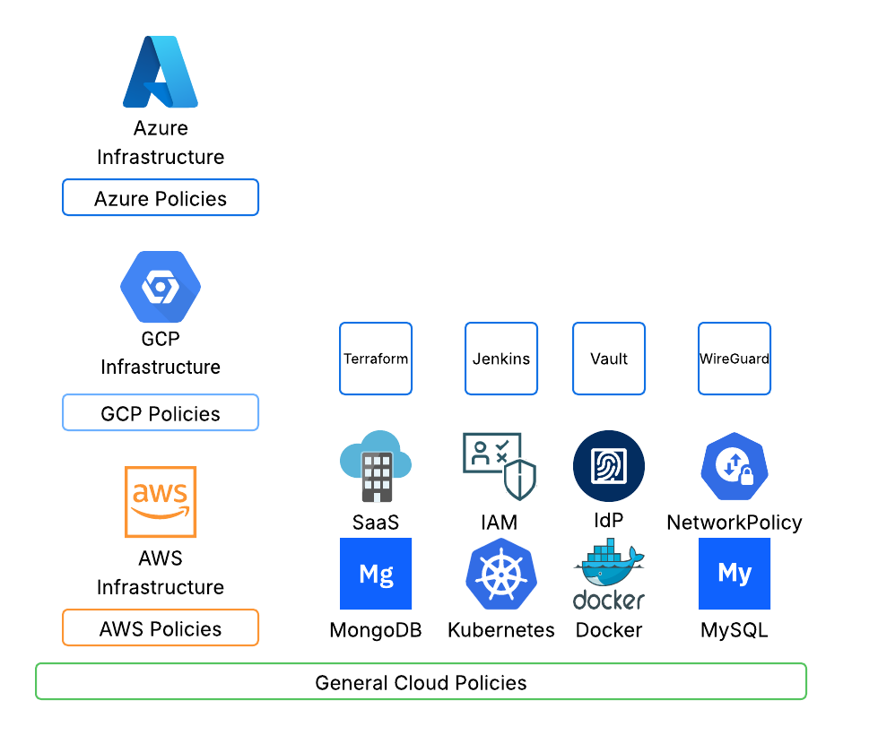
Security at Scale – Where do we start?
Notes:
Discuss how we calculate security cost in terms of possible loss

Slide 19
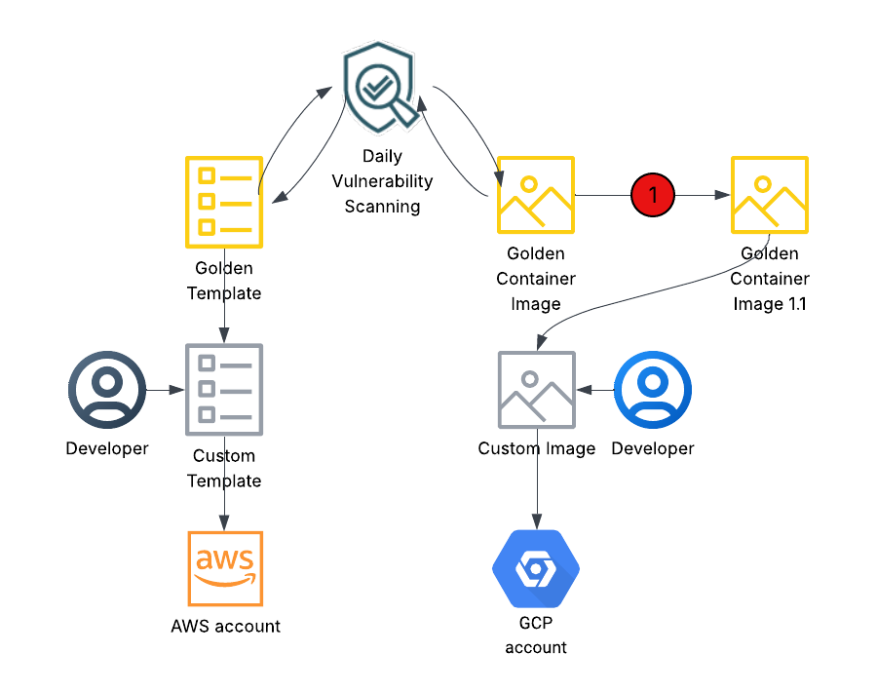
Security at Scale
The “Golden” Solution
How can we integrate security at the base
  Basic feature set to be built on
  Continuously scanned and vetted
  Owned by the security team
  Provide enough variation to allow developer freedoms
Golden Examples
  IaC template to deploy an s3 bucket
  Container image using RedHat distro
  Ec2 template with agents built-in
  AWS account creation with built-in POLP roles
Notes:
Do you manage isolated, or at a high level? When do you do what?

Slide 20
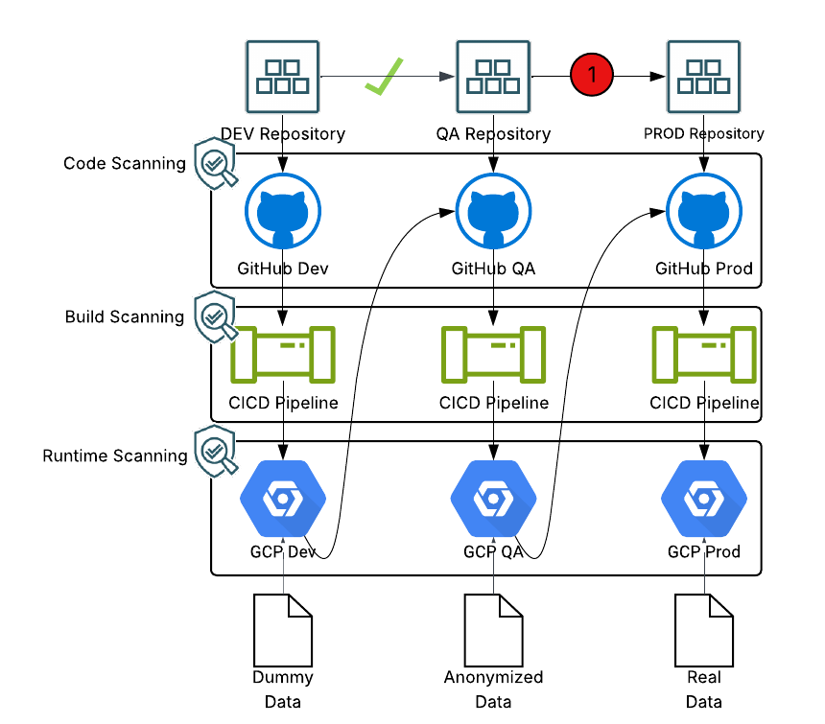
Security at Scale
Gated CICD & Codebase Validation
What can we stop before it reaches production?
  Github code scanning solution
  CICD deployment scanning
  Gated CICD pipelines by environment
  A mixed combination can lead deployments to prod being clean and safe

Slide 21
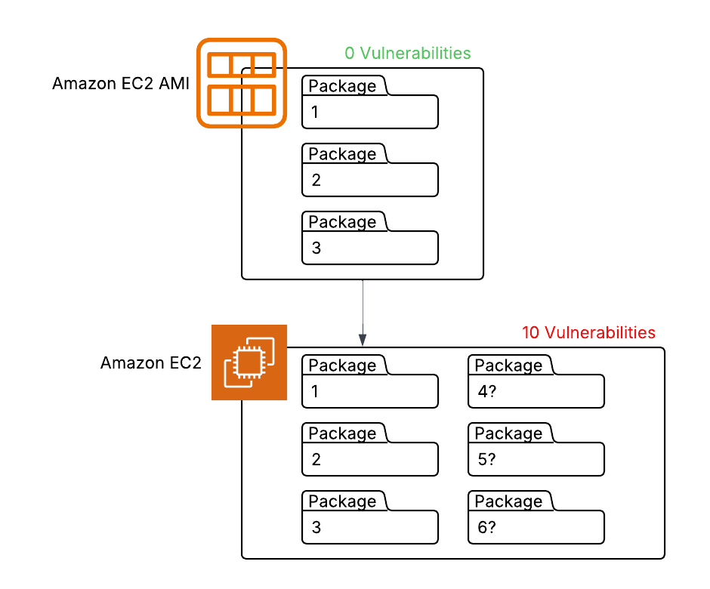
Security at Scale
Don’t forget about Dynamic!
A photo doesn’t tell you everything
  Static scanning can only provide you so much information
  It’s easy to miss packages called at runtime
  Remediate at the root, but alert across the whole deployment
What is drift?
  When the static configuration doesn’t match the running one, something is up
  Drift detection in running assets
  Could mean potential tampering or overly permissive resources
Notes:
Photo of everything on fire
What is multicloud in practice
Multi architecture
Several cloud dependent resources
Siloed processes
High external management

Slide 22
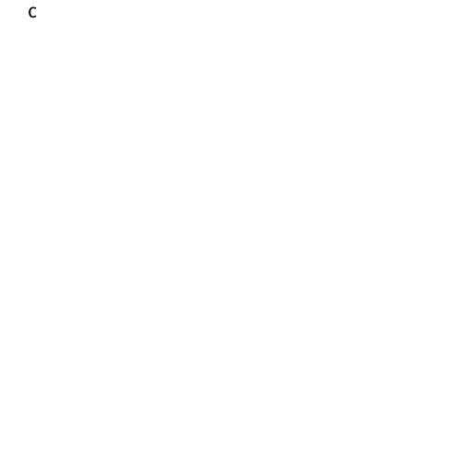
Contextualization
at scale

Slide 23
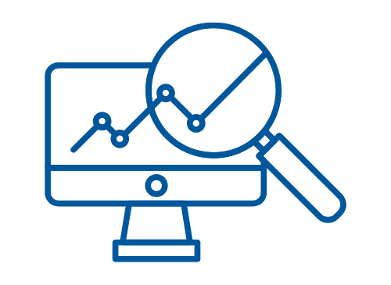
Contextualization at Scale
Is a critical vulnerability critical to you?
  Vulnerabilities are presented in CVSS scores 0-10
  A 9/10 may look bad on paper, but what does it mean to your organization?
Things to consider:
  What kind of data is present?
  Is this production or development?
  Is this duplicated elsewhere?
  What are our compensating controls?
Notes:
Discuss how we calculate security cost in terms of possible loss

Slide 24
Contextualization at Scale
Contextualization at Scale Example
Vuln. 1- CVSS Score 2/10
Vuln. 2- CVSS Score 9/10
Running in production +1
PII data +2
Duplicated in all templates +2
No compensating controls +1
Running in development -1
Dummy data -2
Single instance -2
Locked behind networking restrictions -1
Vuln. 1- Context Score 8/10
Vuln. 2 – Context Score 3/10
Context based CVSS
Base CVSS
Type of cloud env
Type of data
Frequency of finding
Defense in depth
THIS INFORMATION IS CLASSIFIED AS 'SENSITIVE'.
Notes:
Discuss how we calculate security cost in terms of possible loss

Slide 25
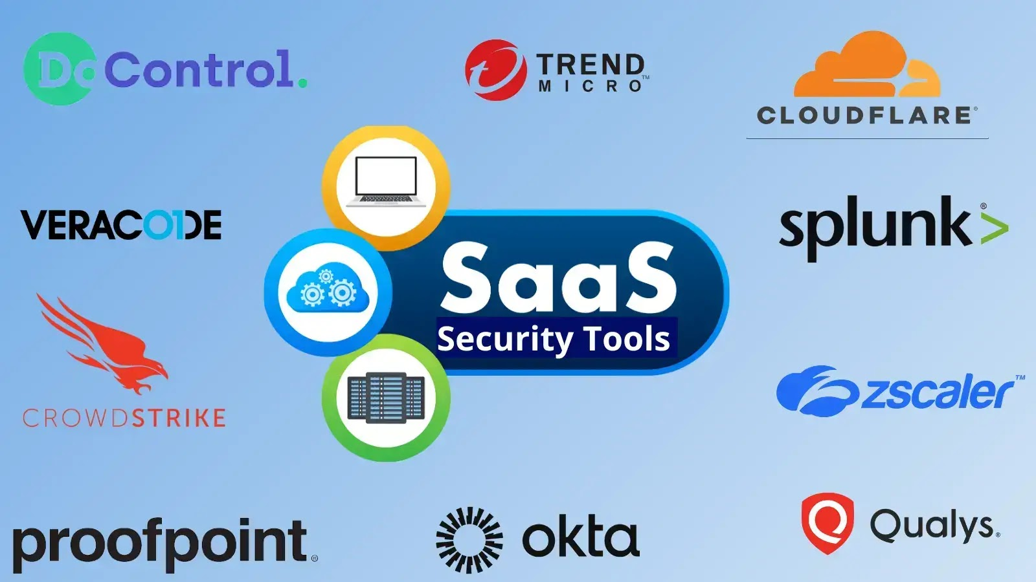
Sometimes you can’t do it all…
  Ex: You may find a need in your organization to secure running processes. If you poll internally and find out it would take the internal teams 1 year to build out this process – you may want to consider implementing a 3rd party service.
What is our bandwidth?
  Sometimes, an external solution is best
  Many vendors offer solutions that they manage with minimal integration requirements
  Balance risk acceptance with risk mitigation
  DRaaS, PaaS, SaaS, IaaS, CaaS
  Remember ROSI

Slide 26

Putting it all
together

Slide 27
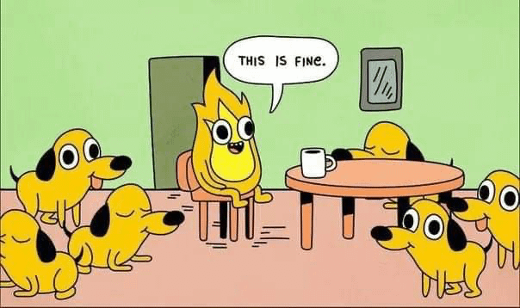
Putting it all together
  The general policies will catch agnostic resources
  Security vetted templates provide freedom and secure baseline builds
  Validation pre-deployment will address static issues
  Gated pipelines means only secure code goes to production
  Dynamic scanning will catch issues in drift/runtime
  Contextualized findings will give you real-world importance
  Look for external decisions if home-grown are not feasible

Slide 28
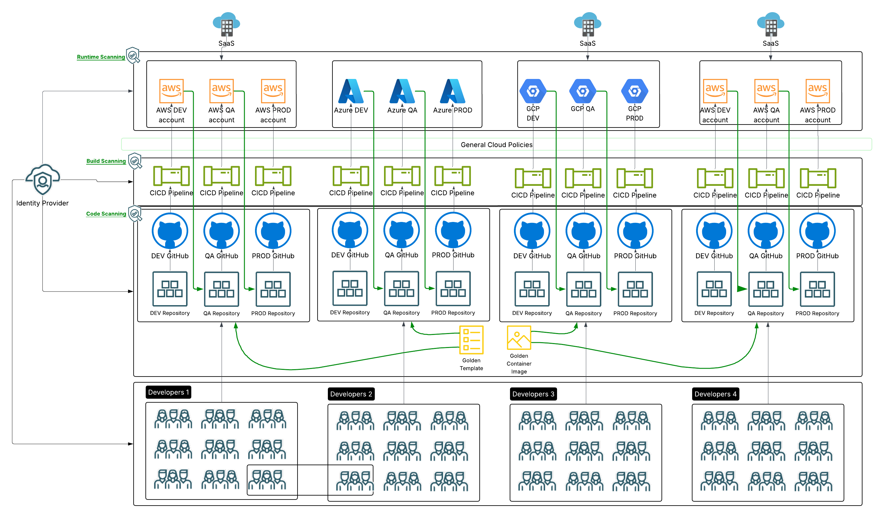
Putting it all together

Slide 29
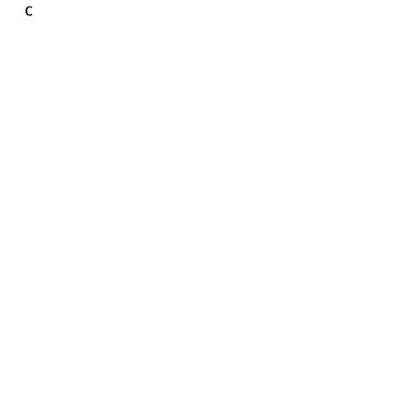
Q&A

