Slide 1

Instruction Manual for Your Next Disaster

Slide 2
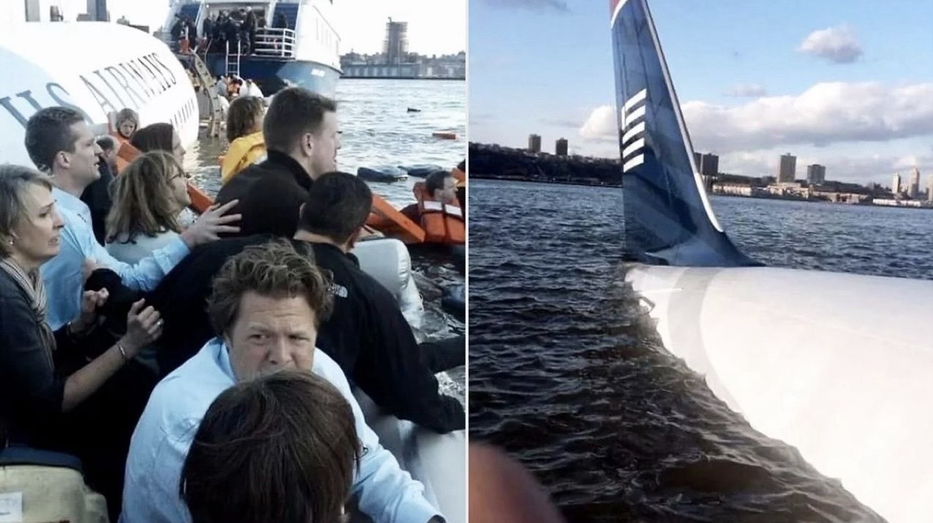
Commence “Freak Out”

Slide 3
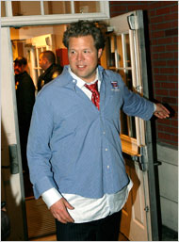
But Then,
Quickly Bounce Back
Recognize that your actions, mindset, and choices play a crucial role in shaping outcomes.
In times of distress, springing into action, staying focused, and helping others can lead to survival and ultimately growth.
Breathe.
Take things
One
Step
At
a
Time.
Emphasize personal agency.
Take control of your narrative and create opportunities for positive results, regardless of circumstances.

Slide 4

Remember the Zen Farmer
There is No Such Thing as Good Luck or Bad Luck.
Instead, it's about how you perceive and respond to life's circumstances.
Farmer’s horse runs away.
Neighbors say: “Such bad luck!”
Farmer replies: “Maybe.”
Horse returns with 10 wild horses.
Neighbors: “Such good luck!”
Farmer: “Maybe.”
Son breaks his leg taming a wild horse.
Neighbors: “Such bad luck!”
Farmer: “Maybe.”
Army comes to draft young men, skips injured son.
Neighbors: “Such good luck!”
Farmer: “Maybe.”

Slide 5
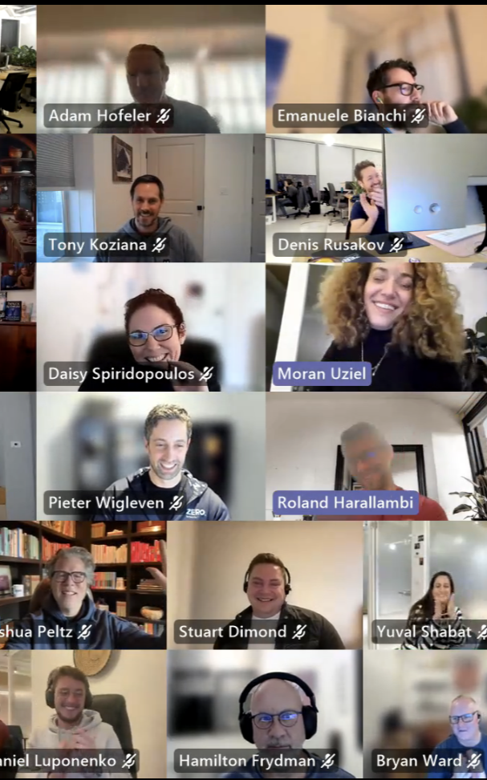


Recognize the Support of Community
Building and nurturing relationships can help you rise from personal and professional lows and find new highs.
Collective strength leads to positive outcomes that benefit everyone involved.
(Huge thanks to Jason Norred, Dr. Chase Cunningham, and Rock Lambros for your friendship and help)

Slide 6

Value Gradual Change
Significant life events may not always lead to immediate, drastic changes.
Focus on your gradual shifts in perspective and appreciation for life that occur over time.
Small, consistent moments of gratitude lead to profound transformation.

Slide 7

And, If You Ever Get the Chance…

Slide 8
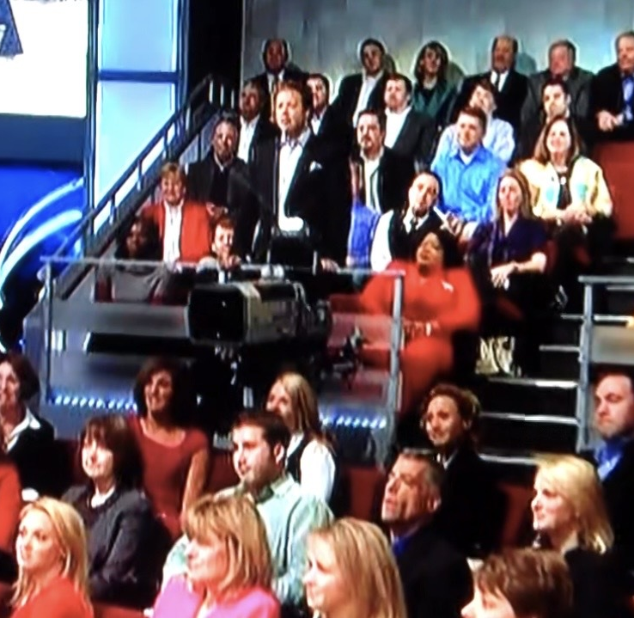
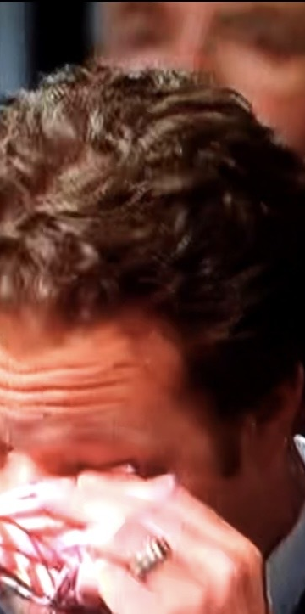
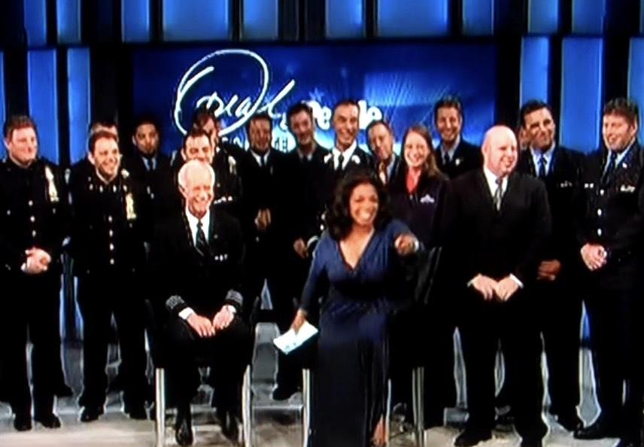
Get Interviewed on National TV
(Try Not to Cry)

Slide 9
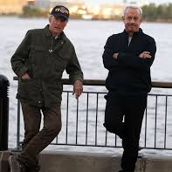
When Clint Eastwood and Tom Hanks Invite You to Be in their Movie…
Say Yes

Slide 10

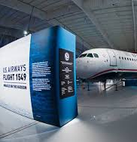
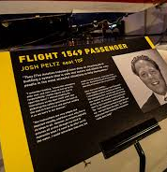
Become a Living Museum Exhibit

Slide 11

Star in a Sequel

Slide 12

And…
If Jimmy, Deb, John and Other Awesome Folks…
Ever Invite You to Present at ISSA…
on Something Wildly Untested,
Mildly Uncomfortable,
and Totally Brand New for you…
Jump at the Chance!

Slide 13
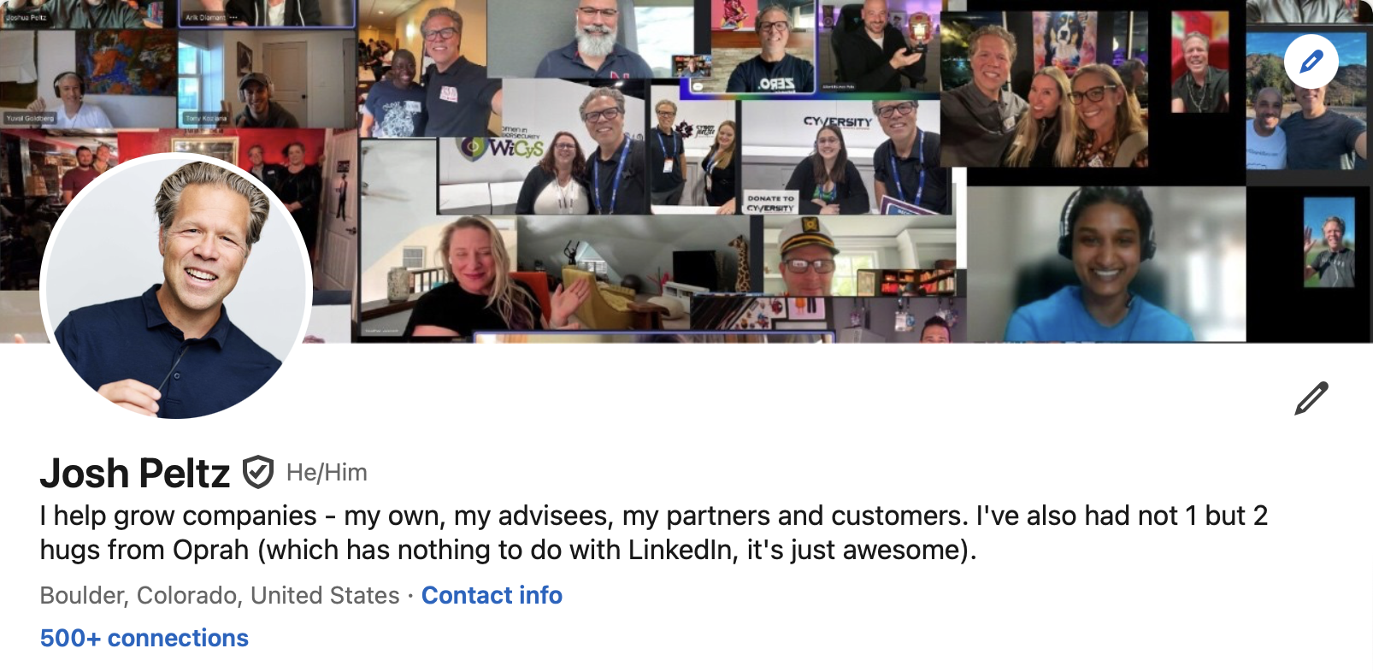
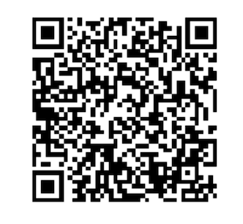

Thank You! My LinkedIn Here →

