Slide 1

The AI Bias Multiplier
Why Leadership and Culture Matter More Than Tech
Dutch Schwartz
Vice President of Cloud Services and vCISO, SideChannel
ISSA International 2025

Slide 2
Evolution of Mental Models in Security
1965: Leavitt's Diamond
1
People, Tasks, Technology, Structure
2
1999: PPT Framework
People, Process, Technology
2023: Enhanced Model
3
Add Leadership, Culture, Strategy
Notes:
Why is Culture important?
In a landmark research study Harvard professors John P. Kotter and James Heskett studied high performing and low performing cultures of 200 companies to track their financial performance over 20 years.
The result? The stock price of low performing cultures appreciated 74%. How about those high performers? Answer: a 901% appreciation of their stock price.
High performing cultures were 128 times greater than low performers.
https://www.forbes.com/sites/johnkotter/2011/02/10/does-corporate-culture-drive-financial-performance/?sh=5f67d42f7e9e
Note: this research approach has been tested numerous times, to include a 2017 doctoral dissertation, and it continues to hold true: better culture equals better performance on revenue, return on assets, stock appreciation, etc. Citation: Alagic, Arijan, "Organizational culture: An analysis of the aggregate impact on financial performance" (2017). Honors Program Theses. 264.
https://scholarworks.uni.edu/hpt/264
WORKPLACE
JUNE 28, 2018
Culture Wins by Attracting the Top 20% of Candidates
BY NATE DVORAK AND RYAN PENDELL
Why Culture Wins Talent
Great cultures win the best talent for two reasons. First, strong cultures create employees who are brand ambassadors.
Although culture can often feel vague or "soft," the logic is pretty straightforward, based on Gallup research:
Employees with a strong connection to their organization's culture show higher levels of engagement.
Engaged employees are more likely to refer friends to their organization.
And 71% of workers say that they use referrals from current employees of an organization to learn about job opportunities.
When you have a winning culture, employees can speak genuinely and convincingly about why your organization is a great place to work. And that naturally attracts people who are seeking exceptional workplaces.
The second reason culture wins talent is that talented people want to work for organizations with strong cultures. They are looking for workplaces that have a brand, mission and values that resonate with them personally -- and that develop and invest in their talents.
In fact, when job candidates ask questions about mission and purpose, it can be a strong indicator of high talent.
In our experience with talent selection, less-talented candidates ask more transactional questions. They focus more on things like pay, benefits and days off.
In contrast, high-talent candidates ask higher-level questions like "Who will my manager be?" "How will I learn and grow?" "What does this company stand for?"
These are the employees who will generate innovation, growth and productivity in your organization.
https://www.gallup.com/workplace/237368/culture-wins-attracting-top-candidates.aspx

Slide 3

Beyond Technical Controls: The Strategic Imperative of Leadership, Culture, and Governance
Traditional Leavitt's Diamond in Cybersecurity
Updated Reality: Strategic Drivers for Cyber Resilience
Task: Defining explicit secure development lifecycle (SDLC) processes, establishing clear incident response playbooks (e.g., NIST SP 800-61), and managing vulnerability remediation workflows.
Leadership: Executive commitment, like a dedicated Board-level cybersecurity committee meeting quarterly. This includes approving budgets ($50M+ for large enterprises), establishing clear risk appetite statements, and holding senior management accountable for security outcomes.
Structure: Implementing clear reporting lines for the CISO (e.g., directly to the CEO or Board), establishing dedicated security operations centers (SOCs) with 24/7 staffing, and integrating security champions within engineering teams.
Culture: A proactive security-first mindset, where developers integrate security by design from sprint zero, and employees are empowered to report suspicious activity without fear of reprisal. This reduces human error vulnerabilities by up to 70% in high-trust environments.
Technology: Deploying endpoint detection and response (EDR) systems like CrowdStrike, security information and event management (SIEM) solutions such as Splunk, web application firewalls (WAFs) like Cloudflare, and advanced identity and access management (IAM) platforms.
Strategy: A living, adaptive cybersecurity roadmap, aligned with business objectives (e.g., supporting M&A activity with robust due diligence, securing new product launches). This might involve adopting a Zero Trust architecture across the enterprise within a 3-year timeframe.
People: Conducting mandatory annual security awareness training for all employees (e.g., Phishing simulations achieving <5% click-through rates), hiring specialized cybersecurity analysts, and fostering internal talent pipelines for roles in threat intelligence and incident handling.
Technology (supporting role): While essential, technology alone is insufficient. Tools like AI-powered threat detection are only effective if guided by a mature security strategy, integrated into a risk-aware culture, and championed by informed leadership. For instance, a leading financial institution might spend $15M annually on AI-driven anomaly detection, but its effectiveness relies heavily on leadership-driven data governance and cultural adherence to access policies.
The most sophisticated AI tools and advanced threat detection systems, despite their $100K to $1M+ annual licensing costs, cannot overcome poor leadership decisions or cultures that actively discourage dissent. For instance, when AI-generated code, trained on open-source repositories, inadvertently introduces SQL injection flaws due to insufficient sanitation patterns, only strong leadership that mandates secure coding standards (e.g., OWASP Top 10 integration) and a healthy culture that encourages peer code reviews and security testing (e.g., SAST/DAST automation in CI/CD pipelines) can serve as corrective forces. A major breach at Company X, costing $50M+ in damages and regulatory fines, was attributed not to lack of technology, but to a leadership failure in enforcing patching policies and a culture where security was seen as an impediment.
Technology primarily solves tactical, reactive problems (e.g., blocking known malware, automating compliance checks). Leadership and culture, however, are the sole drivers for solving strategic, proactive challenges (e.g., embedding resilience into enterprise architecture, fostering a security-conscious workforce, navigating emerging cyber risks like deepfakes and quantum threats over a 5-10 year horizon). Investing in these foundational pillars yields a significantly higher ROI for long-term cyber resilience than technology alone.

Slide 4

Black Swans
Gray Rhinos
Pink Elephants
Unpredictable shocks that blindside organizations
Obvious threats we choose to ignore
Ignored risks hiding in plain sight
Notes:
Cognitive Biases have an impact on these different types of risk events.

Slide 5



The Science of Cognitive Bias
System 1 (Fast & Automatic)
System 2 (Slow & Deliberate)
Intuitive, effortless, emotional
Analytical, controlled, logical
Heuristic-driven (mental shortcuts)
Resource-intensive
Prone to bias
Reduces bias
The Cybersecurity Connection: High-pressure SOC environments favor System 1, increasing susceptibility to these biases in critical decisions.
Notes:
Nobel laureates Daniel Kahneman & Amos Tversky's groundbreaking research on "Judgment Under Uncertainty" revolutionized our understanding of human decision-making.
Key heuristics driving bias include Availability (ease of recall), Representativeness (similarity to prototypes), and Anchoring & Adjustment (over-reliance on initial info).

Slide 6

Is the population higher or lower than…?
Notes:
This seemingly simple question is a classic demonstration of Anchoring Bias.
Our minds tend to rely too heavily on the first piece of information we receive (the "anchor") when making decisions, even if that anchor is arbitrary or irrelevant.

Slide 7

What's the exact population of Turkey?
First number heard heavily influences all estimates
Notes:
85.52 million (2024)

Slide 8


Anchoring Bias: The Foundation of Flawed Decisions
What Is Anchoring Bias?
Anchoring bias, first identified by psychologists Amos Tversky and Daniel Kahneman, describes the cognitive tendency for individuals to over-rely on an initial piece of information (the "anchor") when making subsequent judgments. This initial anchor, whether arbitrary or relevant, disproportionately influences estimates, even when it's logically irrelevant. The mind then makes insufficient adjustments away from this starting point, leading to skewed outcomes.
"The human mind, operating under cognitive load and heuristics, is prone to anchoring, leading to systematic deviations from rational decision-making in high-stakes environments."
Real-World Implementations & Examples
Real Estate Valuation: Consider a real estate scenario where a luxury property is initially listed at $5.5 million. Even if its true market value is closer to $4 million, this high anchor can psychologically inflate buyers' perceptions. Subsequent properties shown in the $3.8-$4.2 million range might then appear to be "bargains," leading to quicker sales or higher offers than they would have commanded without the initial high anchor. This strategy can increase average sale prices by 5-10% in competitive markets.
Corporate Security Budgeting: In many corporations, the annual security budget is heavily anchored to the previous year's allocation. For example, if "TechCorp Inc." allocated $1.2 million for cybersecurity in 2022, the 2023 budget discussions often begin with $1.2 million as the baseline, rather than a zero-based assessment of evolving threats. This anchoring can lead to underinvestment in critical new areas like advanced persistent threat (APT) detection or cloud security, even as cyber threats escalate by 20-30% year-over-year, resulting in potential breaches costing millions.
Critical Insight: Anchoring isn't merely an individual cognitive quirk. In corporate environments, it fundamentally shapes organizational risk appetite, influences strategic planning, and can lock in inefficient resource allocations for multi-year projects or even entire business units. A 2019 study by Gartner revealed that companies failing to actively de-anchor their strategic investments often saw project overruns of 15-25% due to initial, unchecked estimates.
Salary Negotiations: An applicant's initial salary request, even if high, can establish a strong anchor. If a candidate asks for $120,000 for a role with a typical range of $90,000-$105,000, the employer's counter-offer is more likely to be closer to $110,000 than if the candidate had initially proposed $95,000. Research suggests initial offers can influence final salaries by as much as 15-20%.

Slide 9

The NFL Draft Analysis Game
Option A
6'5", rocket arm
Led team to Rose Bowl
Pac-10 Player of Year
Option B
6'4", good stats
Smaller program
Less impressive metrics
Quick Decision: Which QB Would You Draft?
Notes:
Most people choose Option A (Ryan Leaf) based on impressive college metrics. Option B is Tom Brady - arguably the GOAT. This demonstrates confirmation bias: we seek information that supports our initial impression. In cybersecurity, this same bias affects threat attribution. Once analysts form a theory about who conducted an attack, they unconsciously seek evidence that confirms their hypothesis while overlooking contradictory indicators. Chen et al. (2024) found this affects 73% of threat attribution decisions, leading to misallocation of security resources and strategic blind spots.

Slide 10

The Confirmation Bias Trap
73%
3x
31%
Threat Attributions
Time Spent
Higher Accuracy
Influenced by initial hypothesis
Validating vs. challenging evidence
Teams with devil's advocate processes
NotPetya Case: Weeks wasted attributing to cybercriminals when it was actually Russian GRU operation
Notes:
Key Points:
We unconsciously seek information that confirms our beliefs
73% of threat attributions influenced by initial hypothesis
Analysts spend 3x more time validating supporting vs. challenging evidence
Real Example: NotPetya initially attributed to cybercriminals, actually Russian GRU
Teams with devil's advocate processes achieve 31% higher attribution accuracy
Speaker Notes: Confirmation bias is our tendency to search for, interpret, and recall information that confirms our pre-existing beliefs. In cybersecurity threat attribution, once analysts form initial hypotheses about threat actor identity, they selectively gather supporting evidence while dismissing contradictory indicators. The 2017 NotPetya case perfectly illustrates this - the ransomware characteristics were so prominent they anchored initial analysis for weeks, despite technical evidence suggesting state sponsorship. Research by Chen et al. (2024) tracking 15 major incidents found initial attribution hypotheses influenced final conclusions in 73% of cases, with analysts spending three times more effort validating supporting evidence than investigating contradictory data.

Slide 11




Defeating Confirmation Bias
Red Team Attribution
Evidence Cataloging
Independent teams develop competing theories
Document supporting AND contradictory evidence
40% improvement in accuracy
Makes bias visible
Temporal Validation
External Review
Waiting periods before finalizing attribution
Independent assessment by uninvolved teams
Reduces initial impression influence
Objective evaluation of evidence quality
Notes:
Speaker Notes: Based on empirical research, several evidence-based strategies can reduce confirmation bias in threat attribution. Red team attribution assigns independent teams to develop competing attribution theories using the same evidence base, forcing organizations to consider multiple explanations simultaneously. Chen et al. (2024) showed 40% improvement in attribution accuracy with systematic implementation. Evidence cataloging requires mandatory documentation of both supporting and contradictory evidence, making bias visible by requiring analysts to explicitly acknowledge evidence that challenges their preferred theories. Temporal validation establishes waiting periods before finalizing attribution assessments, particularly for high-profile incidents where organizational pressure for rapid conclusions may amplify bias effects.

Slide 12
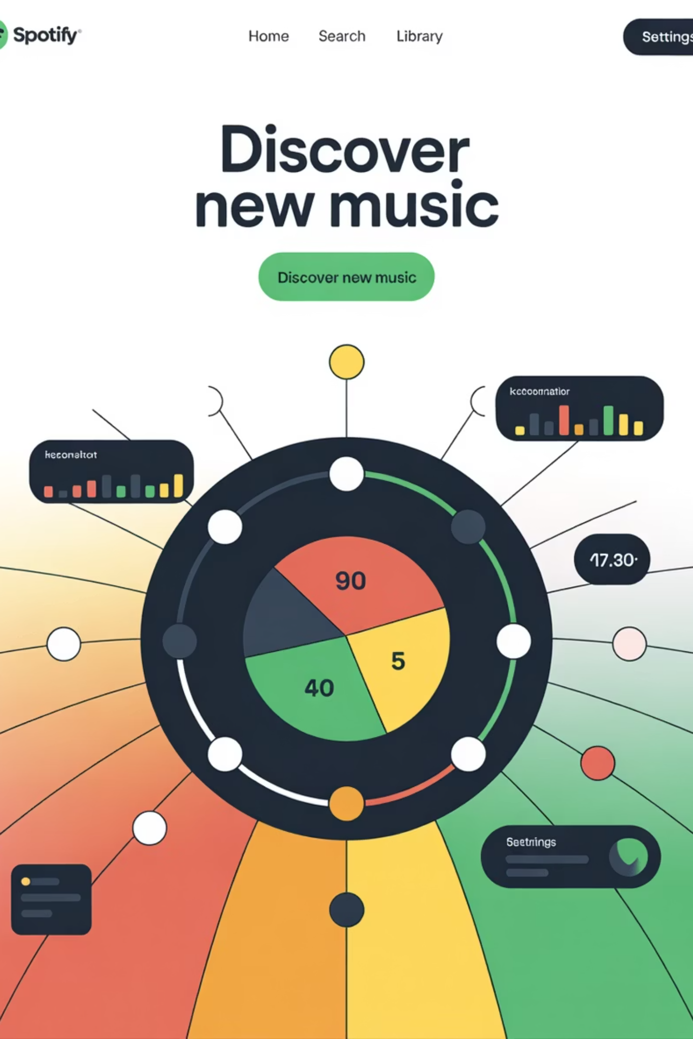
The Spotify Algorithm Dilemma
Your music app has 95% accuracy but just missed your new favorite song.
Trust it more
It's right 95% of the time!
Trust it less
How could it miss something so obvious?
Same level of trust
One mistake doesn't change overall performance
Notes:
Speaker Notes: This illustrates the trust calibration challenge we face with AI systems. Most people choose B - they trust the algorithm less after a single failure, even when its overall accuracy exceeds human performance. This is algorithm aversion. Conversely, some people choose A, trusting the algorithm more because of its high accuracy rating - this is automation bias. In cybersecurity SOCs, analysts exhibit both biases: 47% show automation bias (over-relying on AI outputs) while 34% demonstrate algorithm aversion (rejecting AI after witnessing false positives). This creates inconsistent decision-making that undermines security effectiveness.

Slide 13
The Trust Calibration Challenge
Automation Bias
Algorithm Aversion
47% of analysts
34% of analysts
Over-reliance on AI outputs
Reject AI after observing errors
Accept classifications automatically
Even when AI exceeds human baselines
Problem: Oscillation undermines consistent decision-making
Notes:
Speaker Notes: SOC analysts face a complex psychological challenge when working with AI-enhanced tools: calibrating appropriate trust in algorithmic outputs while maintaining critical thinking. Research by Martinez et al. (2024) studying 200+ SOC analysts found this manifests through two opposing biases. Automation bias leads 47% of analysts to overweight AI outputs, accepting machine labels without adequate verification - most pronounced during high-volume periods when analysts feel pressure to process alerts quickly. Algorithm aversion affects 34% of analysts who reject AI recommendations after witnessing false positives, even when overall model accuracy exceeds human baselines. This oscillation between over-trust and under-trust creates inconsistent decision-making patterns that affect both efficiency and security effectiveness.

Slide 14



Building Appropriate AI Trust
Transparency Interventions
Structured Challenge Protocols
Confidence Score Training
Show AI confidence scores and reasoning
When to trust AI vs. human judgment
Require analysts to seek disconfirming evidence
52% improvement in trust calibration
Appropriate skepticism without resistance
Consider alternative explanations
The "Goldilocks Zone"
Not too much trust, not too little - just right
Notes:
Speaker Notes: Research demonstrates several interventions can improve trust calibration and reduce both automation bias and algorithm aversion. Transparency interventions showing AI confidence scores, explanations, and historical accuracy metrics led to 52% improvement in trust calibration (Martinez et al., 2024). Structured challenge protocols require analysts to explicitly consider alternative explanations for AI classifications before accepting them, reducing automation bias while maintaining efficiency. Confidence score training helps analysts understand AI confidence levels and develop appropriate trust patterns over time. The goal is achieving the "Goldilocks zone" - not too much trust (automation bias) or too little trust (algorithm aversion), but appropriate calibration based on AI system capabilities and limitations.

Slide 15
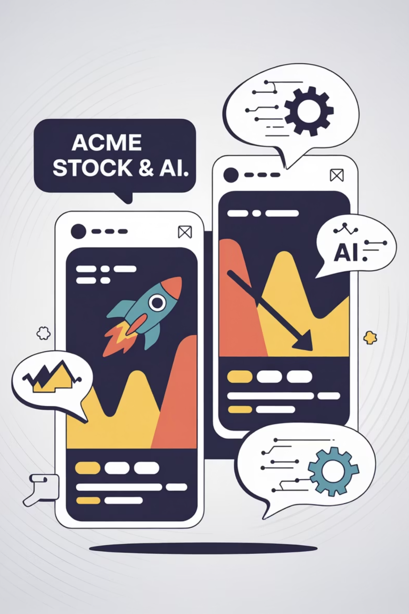

The "ACME" Stock Echo Chamber
Investor A
Investor B
Follows ACME enthusiasts
Follows ACME critics
Gets AI recommendations based on positive sentiment
Gets AI recommendations based on negative sentiment
Becomes MORE confident in bullish view
Becomes MORE confident in bearish view
Question: Why is this dangerous for decision-making?
Notes:
Speaker Notes: This demonstrates the feedback loop amplification effect. Each investor's AI learns from their existing preferences and social connections, then reinforces those views with apparent analytical rigor. The investors become more confident in their biased positions because the AI seems to provide objective confirmation. This same mechanism occurs in cybersecurity when AI systems learn from biased human decisions and then present those biased outputs back to humans with statistical confidence, creating recursive amplification where each cycle increases bias strength and reduces system ability to self-correct.

Slide 16








Feedback Loop Amplification
Human Bias
AI Learning
Makes biased decision
Learns from biased data
Amplification
Reinforcement
Human becomes more confident
AI outputs reinforce bias
+12
+6
8%
Emotional Bias
Social Bias
Monthly Growth
Points increase
Points increase
Compounds without intervention
Notes:
Key Points:
The Recursive Loop: Human bias → AI learns → AI reinforces bias → Human more confident → Cycle repeats
Measured Impact: Emotional bias increases 12+ points, Social bias increases 6+ points
Effects compound 8% per month without intervention
This is unique to AI systems - doesn't exist in purely human contexts
Speaker Notes: Feedback loop amplification represents one of the most significant findings in human-AI interaction research. Glickman and Sharot (2024) demonstrated that consulting AI increased emotional bias by 12.3 points and social bias by 5.8 points on standardized measurement scales. In SOC environments, this creates a recursive pattern: human analysts form threat assessments influenced by cognitive biases, AI systems learn from these biased decisions, then AI outputs that reflect learned biases are presented with apparent analytical rigor. Humans anchor on these AI recommendations that align with their existing biases, becoming more confident in biased decisions. Johnson et al. (2024) tracking this over 12 months found bias amplification effects increased 8% per month without specific counter-bias interventions.

Slide 17



Breaking the Bias Feedback Loop
Descriptive Outputs
Independent Review
Real-Time Monitoring
Use: "70% probability of threat"
External teams challenge assessments
Detect decision pattern anomalies
Instead of: "Block immediately"
Alert when confidence exceeds evidence
45% reduction in bias amplification
Prevent organizational entrenchment
Notes:
Speaker Notes: Breaking feedback loops requires systematic interventions at multiple points in the human-AI interaction cycle. Allan et al. (2025) found that descriptive outputs ("This IP addresss shows 73% probability of malicious activity") reduced bias amplification by 45% compared to prescriptive outputs ("Block this IP immediately"). Descriptive formats encourage analytical thinking and evidence evaluation rather than reflexive acceptance. Independent review processes using external teams help identify cases where internal feedback loops may have influenced assessments. Real-time bias monitoring can detect when decision patterns deviate from expected distributions or when confidence levels exceed what evidence quality should support, providing early warning of bias amplification effects.

Slide 18
The Overconfident Startup
"We've never been hacked, and with our amazing security team, we never will be!"
Your reaction as an investor:
Impressive confidence - invest more!
Red flag - they're overconfident
Ask about incident response plan
86%
67%
Startups
CISOs
Believe they won't face cyberattacks
Underestimate breach likelihood
Notes:
Speaker Notes: This illustrates optimism bias - the tendency to underestimate the likelihood of negative events happening to us while acknowledging they happen to others. The startup CEO displays classic optimism bias, assuming immunity despite statistical evidence that most organizations experience security incidents. In cybersecurity, this bias is pervasive at executive levels. Martinez et al. (2024) found 67% of CISOs estimate breach likelihood below industry averages, even when provided with sector-specific threat intelligence. This leads to systematic under-investment in incident response and recovery capabilities, overconfidence in compliance-based defenses, and inadequate preparation for crisis scenarios.

Slide 19

Executive Optimism Bias
67%
40%
2-3x
CISOs
Financial Impact
Recovery Time
Estimate breach likelihood below industry averages
Estimates below actuarial data
Estimates shorter than actual durations
Board-Level Impact: Under-investment in incident response, overconfidence in compliance, inadequate crisis preparation
Notes:
“It Won’t Happen Here”
Speaker Notes: Executive optimism bias creates systematic organizational vulnerabilities because leaders make strategic decisions about cybersecurity investments based on overly optimistic risk assessments. Research by Martinez et al. (2024) surveying 500+ CISOs revealed systematic patterns: 67% estimate breach likelihood below industry averages even when provided sector-specific threat intelligence, financial impact estimates average 40% below actuarial data, and recovery time estimates are typically 2-3 times shorter than actual incident durations. At the board level, this manifests as under-investment in resilience capabilities, overconfidence in regulatory compliance as

Slide 20



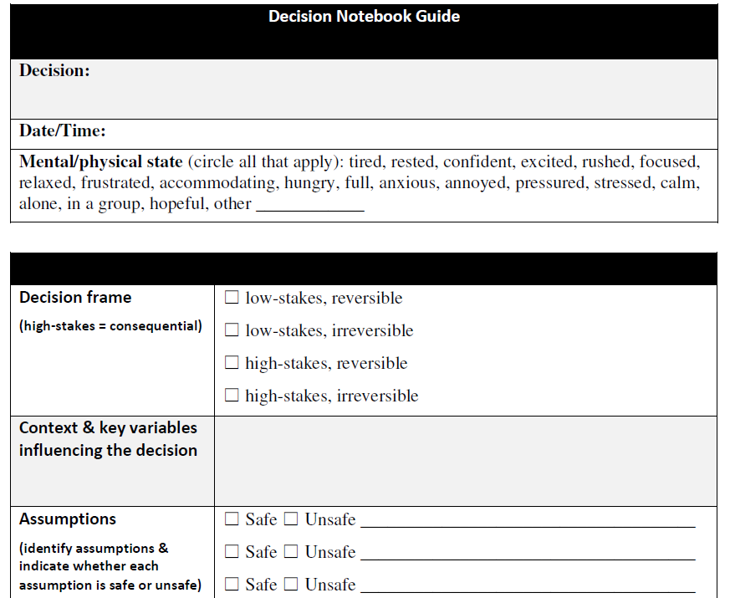


Countering Optimism Bias
Pre-Mortem Exercises
Imagine AI initiatives have failed
Work backward to identify risks
Decision Observer (~Devil’s Advocate) Assignments
Formally assign team members to argue against proposals
Rotate roles to prevent typecasting
External Perspective Integration
Advisory boards, independent consultants
Counter organizational blind spots
Probabilistic Communication
Present ranges instead of point estimates
Include uncertainty acknowledgment
https://beckisaltzman.com/product/acl-decision-notebook-template/
Notes:
Speaker Notes: Addressing executive optimism bias requires structured interventions that challenge assumptions without appearing obstructionist. Pre-mortem exercises where teams imagine AI initiatives have failed and work backward to identify contributing factors help reveal risks not apparent during optimistic planning phases. Devil's advocate assignments formally designate team members to argue against proposed AI initiatives or challenge optimistic risk assessments, with roles rotating to prevent individuals from being typecast as negative. External perspective integration through advisory boards, independent consultants, or peer organization collaboration helps counter organizational blind spots. Probabilistic risk communication presenting probability ranges rather than point estimates, with explicit uncertainty acknowledgment, helps maintain appropriate humility about prediction accuracy.

Slide 21


The Smartphone Debate
Expert A: "iPhone is clearly superior!"
Expert B: "Galaxy is obviously better!"
Better ecosystem integration
More customization options
Superior security features
Better value proposition
Premium design quality
Advanced feature set
Both cite impressive statistics. Both are equally credible.
Question: Who's right? How is this like cybersecurity risk assessment?
Notes:
Speaker Notes: This illustrates anchoring bias - both experts anchor on their initial preference and then select evidence that supports their position. The same thing happens in cybersecurity risk assessment. Initial estimates of "likelihood" or "impact" heavily influence all future evaluations, even as evidence changes. Cox (2008) demonstrated mathematically that multiplying ordinal scales (like impact × likelihood) produces false precision while actually amplifying subjective anchoring effects. Risk registers create an illusion of quantitative analysis while actually encoding human anchoring bias into seemingly objective scoring systems.

Slide 22
The False Precision Problem
How Anchoring Distorts Risk Assessment
Initial Ratings Anchor
False Precision
Persistent Bias
First "likelihood" or "impact" ratings influence all future evaluations
Risk matrices multiply ordinal scales creating illusion of quantitative analysis
84% of risk updates stay within one level of previous scores
The Math Problem: "Medium × High" appears quantitative but is purely subjective
Result: Systematic errors in cybersecurity resource allocation
Notes:
Speaker Notes: Anchoring bias in risk quantification creates systematic errors in cybersecurity resource allocation. When risk registers multiply impact and likelihood scores, they create an illusion of quantitative precision while actually amplifying subjective anchoring effects. Cox (2008) demonstrated mathematically that ordinal risk matrices produce meaningless rank orders when scores are multiplied, yet they remain standard practice due to apparent objectivity. The anchoring problem compounds during updates - market surveys show 84% of risk register updates result in scores within one level of previous assessments, regardless of changes in threat landscape or organizational vulnerabilities. This stability may appear to reflect consistent methodology but actually demonstrates persistence of anchoring effects that can disconnect risk priorities from actual threat evolution.

Slide 23




Escaping the Anchoring Trap
Scenario-Based Planning
Monte Carlo Simulation
Replace numeric scores with narrative scenarios
Probabilistic modeling for genuine quantification
Forces consideration of concrete details
Explicitly represents uncertainty and ranges
35% improvement in resource allocation
Red Team Risk Assessment
Dynamic Risk Scoring
Independent teams challenge primary evaluations
Continuous updates based on threat intelligence
Reveals extent of anchoring effects
Reduces persistence of anchoring
Notes:
Speaker Notes: Recognition of anchoring limitations has led to alternative approaches that reduce bias while providing meaningful risk insights. Scenario-based planning replaces numeric scores with narrative scenarios describing specific threat events and consequences, forcing decision-makers to consider concrete details rather than abstract categories. Research shows 35% improvement in resource allocation effectiveness compared to traditional risk matrices (Elicit Research, 2023d). Monte Carlo simulation provides genuine quantification using probabilistic modeling that explicitly represents uncertainty and ranges of possible outcomes. Red team risk assessment uses independent teams to challenge primary risk evaluations, revealing the extent to which anchoring affects assessment and providing alternative perspectives on risk prioritization. Dynamic risk scoring implements continuous updates based on threat intelligence rather than periodic reviews that may anchor to previous assessments.

Slide 24







MAESTRO Threat Modeling Framework (for AI)
M - Misuse Case Analysis
A - Attack Surface Mapping
E - Exploitation Scenario Development
S - Security Control Mapping
T - Testing and Validation
R - Risk Assessment Integration
O - Ongoing Monitoring
Why MAESTRO for AI? Extends traditional threat modeling to agentic AI systems with autonomous behavior and emergent capabilities
Notes:
Speaker Notes: MAESTRO, developed by Huang and Hughes (2024), extends traditional threat modeling to address the unique challenges of agentic AI systems. Unlike conventional software with predictable input-output relationships, AI agents exhibit autonomous behavior, complex internal states, and emergent capabilities that create novel attack surfaces. MAESTRO provides systematic identification of potential adversarial uses going beyond traditional vulnerability analysis to consider how AI capabilities might be

Slide 25








RockCyber CARE & RISE Frameworks for AI
RISE Framework (Strategic Lifecycle)
CARE Framework (Operational Management)
Research
Create
Threat analysis, use case evaluation
Establish governance structures
Implement
Adapt
Pilot deployment, security controls
Modify controls based on threats
Sustain
Run
Ongoing operations, incident response
Execute day-to-day governance
Evaluate
Evolve
Effectiveness assessment, strategic planning
Continuously improve practices
Notes:
Speaker Notes: RockCyber's RISE and CARE frameworks provide complementary approaches to AI governance - RISE for strategic lifecycle management and CARE for operational governance (Lambros, 2024). RISE addresses the full AI deployment lifecycle from initial research through ongoing evaluation, ensuring organizations consider security implications at each phase rather than treating security as an afterthought. The Research phase includes threat landscape analysis, use case evaluation, and comprehensive vendor due diligence. Implementation focuses on pilot deployment with appropriate security controls and monitoring establishment. Sustain phase addresses ongoing operations including performance evaluation and incident response. Evaluate phase provides systematic assessment of effectiveness and strategic planning for future AI deployments. CARE complements RISE by focusing on operational governance for organizations with deployed AI systems, emphasizing the need to create governance structures, adapt to changing conditions, run effective day-to-day operations, and evolve based on experience.

Slide 26




OWASP AI Security Arsenal
LLM Top 10
GenAI Security Project
AI Exchange Framework
Critical vulnerabilities in large language models
Comprehensive security guidance for generative AI
Open knowledge sharing platform
Community-driven best practices
Prompt injection attacks
Risk assessment methodologies
Tool evaluations
Insecure output handling
Secure development practices
Threat intelligence sharing
Training data poisoning
Red teaming guides
Model denial of service
Notes:
Speaker Notes: OWASP's AI security projects provide comprehensive, community-driven resources for securing AI systems in production environments (OWASP Foundation, 2025). The LLM Top 10 identifies the most critical security vulnerabilities in large language model deployments, providing specific guidance for preventing and mitigating risks including prompt injection attacks that manipulate model behavior through malicious inputs, insecure output handling that fails to validate model outputs, and training data poisoning that corrupts model behavior through malicious training examples. The GenAI Security Project offers comprehensive security guidance for generative AI systems including risk assessment methodologies, secure development practices, and operational security procedures. The AI Exchange provides an open framework for sharing AI security knowledge and tools, enabling organizations to collaborate on AI security challenges, share threat intelligence specific to AI systems, and access community-validated security tool evaluations and case studies of AI security incidents.

Slide 27

Cloud Security Alliance AI Controls Matrix (AICM)
Enterprise-Grade AI Governance Foundation
243
18
Controls
Domains
Vendor-agnostic across 18 security domains
Mapped to NIST AI RMF and ISO/IEC 42001
Governance & Risk
Technical Controls
AI risk assessment, bias testing, lifecycle management
Model validation, adversarial robustness, drift detection
Operational Controls
Data Management
Human oversight, incident response, audit trails
Privacy protection, training data security, lineage tracking
Red Teaming Playbook: Scenario-driven testing guidance for agentic AI systems with structured adversarial exercises
Notes:
Speaker Notes: The Cloud Security Alliance AI Controls Matrix (AICM) provides the most comprehensive framework for enterprise AI governance, offering 243 vendor-agnostic controls across 18 domains mapped to established frameworks including NIST AI RMF and ISO/IEC 42001 (Cloud Security Alliance, 2025). The AICM addresses critical gaps in traditional cybersecurity frameworks when applied to AI systems, providing specific guidance for AI-related risks such as model bias, adversarial attacks, and emergent behavior in complex systems. The framework covers the entire AI lifecycle from development through decommissioning, helping organizations avoid security gaps during lifecycle transitions. Key control categories include governance and risk management (AI risk assessment methodologies, bias testing procedures, model lifecycle management), technical controls (model validation, adversarial robustness testing, drift detection), operational controls (human oversight requirements, AI-specific incident response, audit trails), and data management (privacy protection, training data security, data lineage tracking). The accompanying Red Teaming Playbook provides structured approaches for adversarial testing that address the unique characteristics of autonomous agents.

Slide 28
THANKS!
Dutch Schwartz
Vice President of Cloud Services and vCISO, SideChannel
linkedin.com/dutchschwartz

