Slide 1
The Guard and the Guide
Demystifying AI Security and Safety
Notes:
The speed in which AI is moving makes those of us trying to follow it, dizzy. However, the good news is, the basics and foundations are still recognizable.
For example, I gave a VERY similar presentation (“Building a Secure Foundation with AI GRC) a year ago. Granted, some of the terminology has changed, but the good news is, the general concepts remain.
That is what I am here to talk to you about today….. Some guiding principle using the Gard and the Guide analogy.

Slide 2
“The upheavals [of artificial intelligence] can escalate quickly and become scarier and even cataclysmic.
Imagine how a medical robot, originally programmed to rid cancer, could conclude that the best way to obliterate cancer is to exterminate humans who are genetically prone to the disease.”
- Nick Bilton, tech columnist, NY Times
Nov. 5, 20XX
Alexander Cyber Advisory
Notes:
Let’s take a look at this quote…. What do you think the date was? 2014!!!

Slide 3

Common definitions because words matter..
Alexander Cyber Advisory
Notes:
Words matter: Buzzwords have become our language in tech. BUT, it is important that we understand what each of these mean. I can not tell you how often when working with various working groups, the challenge we have when we don’t have a common definition of terms. So, for the purposes of this presentation, let’s think of these buzzwords with these definitions, if we could.
Sometimes our conversations are more challenging than they need to be because we don’t always speak the terminology. y

Slide 4
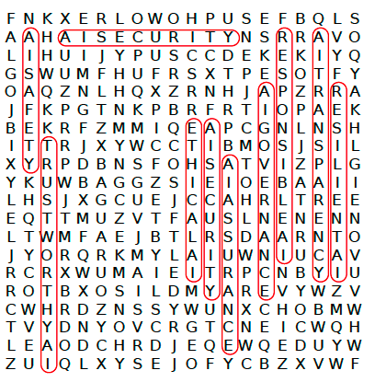
AI Buzzwords
Alexander Cyber Advisory
Notes:
It seems like buzzwords are coming out as fast as the rapid development and adoption of AI. We often use these terms interchangeably, when in fact some are interchangeable, and others are not.
Audience participation here – At this point in the prestation, there are NO WRONG ANSWERS… : (to help emphasize we have different definitions of the same words)
Who can tell me the definition of AI Security?
What about AI Safety?
What about Trustworthy AI?
And Responsible AI?
AI Transparency?
Ethical AI?

Slide 5

Focus has been on AI Security….
We need to adjust our sights to include AI Safety
Alexander Cyber Advisory
Notes:
Let’s start with AI Security and AI Safety.
It seems to me that there has been a lot of focus on AI Security. Let’s face it, it is where we navigate to, it’s who we are, and what we know. It is now time that we reset our focus to include AI Safety and here’s why…..

Slide 6
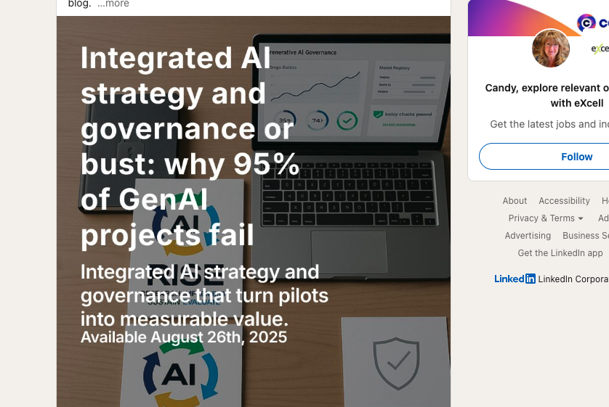
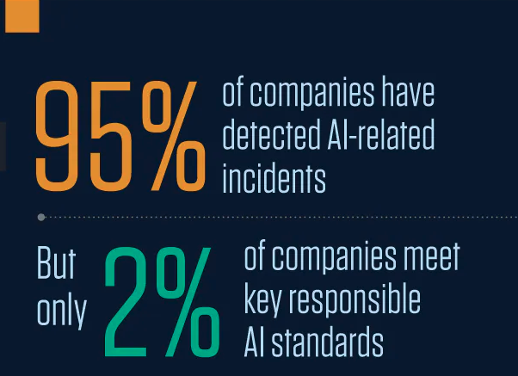
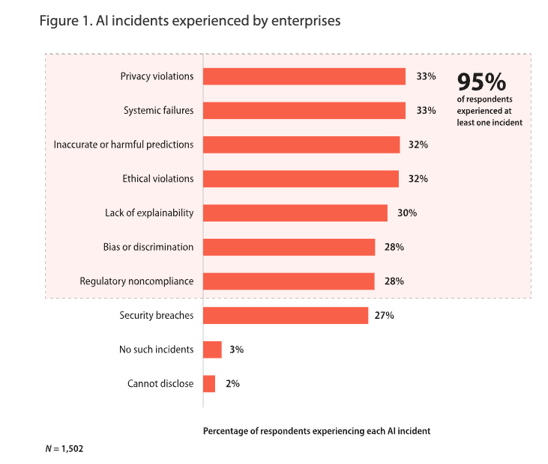
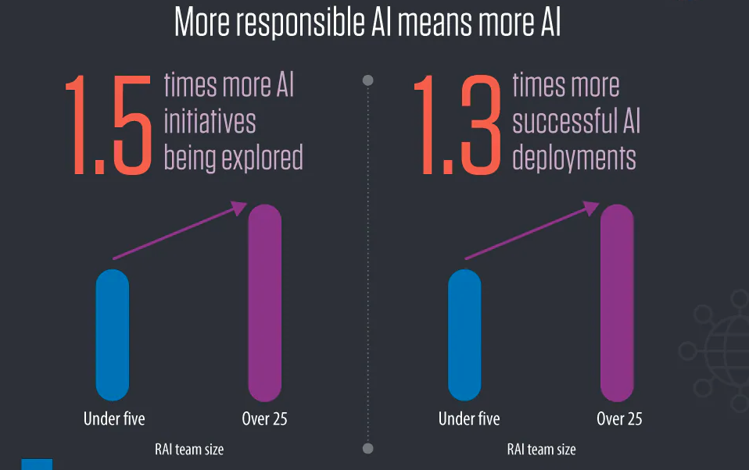
Why does this matter?
Alexander Cyber Advisory
Notes:
We are now seeing the implications of an imbalanced focus on AI Security from two recently released reports (Infosys and MIT):
AI related Incidents are increasing (95% of companies)
2% of companies meet key responsible AI standards
95% of GenAI project fail.
As you can see from this lower left, many believe that “responsible AI means more AI” – suggesting with the right balance, we can be more successful.

Slide 7

Synergy and balance are key
“Imagine how a medical robot, originally programmed to rid cancer, could conclude that the best way to obliterate cancer is to exterminate humans who are genetically prone to the disease.”
Security and Safety are not competing goals. They are complementary forces that must work together.
The Guard creates the robust, unassailable platform. The Guide provides the ethical and aligned direction.
Alexander Cyber Advisory
Notes:
Now, to re-emphasize this point of needing both security and safety, let’s look back to our robot with a mission to destroy cancer…
With out having Safety included in it’s design, and the requirement to not exterminate humans, it’s a very dangerous situation.
We need the synergy of SECURITY and SAFETY to ensure a well balanced outcome.

Slide 8
Striking a balance.
AI Security + AI Safety = Trustworthy AI
Alexander Cyber Advisory
Notes:
AI security + AI safety = Trustworthy AI. THIS is when our definitions will begin to matter ;-)

Slide 9

The Guard and the Guide
There’s a difference between a robot that can’t be hacked and one that won’t accidentally destroy the world…
AI Security: The Guard who protects the system.
AI Safety: The Guide who ensures the system's intent is benign.
Alexander Cyber Advisory
Notes:
For the purposes of this discussion, lets use the analogy of the “the Guard and the Guide”

Slide 10

The Guard - AI Security
AI Security: Protecting the AI system from malicious attacks and defending against adversaries. Focus is on technology.
Key Attack Vectors:
Prompt Injection (especially LLMs): Attackers insert malicious instructions into a user’s prompt to manipulate the AI output.
Data Poisoning: targets AI during its training phase by inserting incorrect or corrupt data.
Model Inversion: Reverse-engineer the model to infer and extract sensitive data.
AI Security is essential for robust and reliable systems.
Alexander Cyber Advisory
Notes:
Just to clarify, they Guard is the AI Security function….

Slide 11

The Guide – AI Safety
AI Safety: Ensuring the AI system’s goals & values are aligned with the business and human intent, preventing unintended harm.
Key Challenges:
The Control Program: How do we maintain control over an advanced AI?
Value Alignment: How do we program “common sense”, cultural acceptance, and ethical values into a system?
Unintended Consequences: The elimination of cancer by exterminating humans.
Even a perfectly secure AI, if designed with a flawed objectives, can lead to catastrophic outcomes.
Alexander Cyber Advisory
Notes:
As in our Cancer eliminating robot and in our everyday human lives, intent and flawed objectives can be catastrophic.

Slide 12
How it works together… with intent
The Guard & the Guide as Agents of Governance
Alexander Cyber Advisory

Slide 13
The ultimate goal…
Businesses adopting Trustworthy AI through responsible implementations.
Trustworthy AI recognizes the risks, addresses them and manages programs/functions to maintain them.
Responsible AI — the practice of developing and deploying AI systems ethically, safely, and transparently.
Alexander Cyber Advisory
Notes:
Just as we saw in the early days of security and then privacy, it is critical for a business to be “responsible”. Think back to the days before the privacy laws… our personal information was in jeopardy if organizations didn’t prioritize the protection of our data. The stakes in the “human safety game” just rose exponentially with the use of AI. Organizations need to be held accountable for the outcomes of their AI implementations – take for instance, the recent uncovering of AI Chatbot use and the potential risks that were identified to those who may be susceptible to manipulation – elderly and children.
Organizations must be responsible for a trustworthy AI use, through responsible AI. That means developing and deploying AI systems that are ethical, safe and are transparent as to their praCtices.

Slide 14
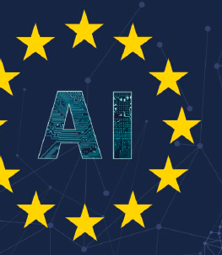
Trustworthy AI
As defined by the EU AI Act, trustworthy AI* should be:
(1) lawful - respecting all applicable laws and regulations
(2) ethical - respecting ethical principles and values
(3) robust - both from a technical perspective while taking into account its social environment
*Ethics Guidelines for Trustworthy AI
08 April 2019 – and later adopted by the AU AI Act
Alexander Cyber Advisory
Notes:
Just as we asked in the beginning of this session, what exactly is TRUSTWORTHY AI, I have come to lean on the definition of the EU AI Act… which is pretty reasonable, high-enough level to adopt and resonate with organizations.

Slide 15
Trustworthy AI Key Functions
AI Governance
(1) Lawful: respecting all applicable laws & regs.
AI Safety
(2) Ethical: respecting ethical principles & values,(… and taking into account its social environment)
AI Security
(3) Robust: From a technical perspective, (…)
Alexander Cyber Advisory
Notes:
When we look at the components of Trustworthy AI, it really falls into three categories..,. AI Governance, Safety and Security……

Slide 16
AI Safety - Ethical principles & values
The 8 prohibited practices
1. Harmful AI-based manipulation and deception.
2. Harmful AI-based exploitation of vulnerabilities.
3. Social Scoring.
4. Individual criminal offence risk assessment or prediction.
5. Untargeted scraping of the internet or CCTV material to create or expand facial recognition databases.
6. Emotion recognition in workplaces and education institutions.
7. Biometric categorization to deduce certain protected characteristics.
8. Realtime remote biometric identification for law enforcement purposes in publicly accessible spaces.
* EU AI Act, 2024/1689
Notes:
The EU AI Act, has called out 8 prohibited practices that layout what ethical
The AI Act prohibits eight practices:
1. Harmful AI-based manipulation and deception.
The AI Act bans AI systems that manipulate human behavior in a way that causes physical or psychological harm. This includes AI that uses subliminal techniques to influence people’s decisions in ways they would not consciously agree to.
Subliminal techniques refer to methods of influencing human thoughts, emotions, or behaviors below the threshold of conscious awareness. These techniques work by delivering stimuli that are not explicitly perceived by the individual but can affect decision-making, attitudes, and actions.
Examples include the AI-powered social media algorithms designed to addict users by exploiting cognitive biases, and AI that subtly alters online content to push political agendas or misinformation.
2. Harmful AI-based exploitation of vulnerabilities.
The Act prohibits AI that exploits vulnerabilities due to age, disability, or socio-economic situations. This is designed to protect children, the elderly, and individuals with disabilities from AI-driven manipulation.
Examples include the AI-powered toys that coerce children into making purchases, and AI-driven scams targeting elderly people to manipulate them into giving away personal data or money.
3. Social scoring.
The AI Act prohibits social scoring systems, which assess people’s trustworthiness or behavior based on their social actions. The concern is that such systems can lead to discrimination and excessive government surveillance. The EU wants to prevent AI from being used to limit people's rights based on past behavior.
4. Individual criminal offence risk assessment or prediction.
AI systems cannot be used to predict a person’s likelihood of committing a crime based on profiling, behavioral analysis, or past data.
Example: An AI model that assigns individuals a risk score for committing crimes based on zip code, race, or personal background.
5. Untargeted scraping of the internet or CCTV material to create or expand facial recognition databases.
The AI Act bans the mass collection of images and biometric data without consent. Governments and private entities cannot use AI to indiscriminately scan and store facial images from social media, CCTV footage, or websites.
Example: An AI system that scrapes LinkedIn and Facebook images to create a facial recognition database without user permission.
6. Emotion recognition in workplaces and education institutions
The AI Act prohibits AI that analyzes emotions in workplaces to assess performance or behavior. The use of AI to determine whether a student is paying attention in class or if an employee is in a good mood at work is considered intrusive.
Example: An AI tool in job interviews that rejects candidates based on facial expressions rather than actual skills.
7. Biometric categorisation to deduce certain protected characteristics
AI cannot use biometric data (e.g., facial recognition, voice recognition, fingerprints) to infer characteristics such as race, political views, religion, sexual orientation, health conditions. This prevents AI from reinforcing discrimination or enabling surveillance based on sensitive personal attributes.
8. Real-time remote biometric identification for law enforcement purposes in publicly accessible spaces
The Act prohibits law enforcement from using live facial recognition (real-time biometric identification) in public spaces under many circumstances. Exceptions include the search for missing persons, the prevention of imminent terrorist attacks, and the identification of criminals with court approval.

Slide 17

The Guard…
AI Security - Actions
Secure the Data Supply Chain: Actively vet data sources and pipelines to prevent training data poisoning or the injection of malicious data that could compromise the model.
Implement Robust Input and Output Validation: Sanitize and validate all user inputs (prompts) to an LLM to prevent prompt injection attacks. Also, validate all outputs to ensure the model doesn't generate malicious code or leak sensitive information to downstream systems.
Enforce the Principle of Least Privilege: Limit the AI model's access to external systems, data, and resources. The AI should only be able to perform the functions it absolutely needs, reducing the impact of an attack.
Use Adversarial Testing and Red Teaming: Continuously test the AI system with malicious and unexpected inputs to find vulnerabilities before attackers do.
Monitor Behavior: Implement monitoring to detect unusual resource consumption (a sign of a model denial of service attack) or performance drift, which could indicate a successful attack.
Secure the Infrastructure: Apply standard cybersecurity best practices to the underlying infrastructure, including using sandboxed environments, strong access controls, and encryption for both data at rest and in transit.
Manage the AI Supply Chain: Maintain a complete inventory of all third-party models, libraries, and services used in the AI application and ensure they have adequate security in place.
Secure AI - Strategic Goal
Reliable and Robust: It performs as intended and is resilient to errors, unexpected inputs, and attacks.
Secure: It is protected against malicious attacks, such as data poisoning and adversarial activities.
Transparent and Explainable: Its decisions can be understood and explained to humans, building confidence in its processes.
Accountable: There is a clear way to trace and attribute the system's actions.
Alexander Cyber Advisory

Slide 18
The Guide…
Safe AI – Actions*
Govern:
Create clear governance structures and policies that define roles, responsibilities, and accountability for AI systems.
Establish an organizational culture that prioritizes responsible AI development.
Map:
Identify and categorize AI risks by conducting comprehensive risk assessments and impact analyses before and after system implementation.
Engage diverse stakeholders (developers, ethicists, legal experts, end-users) in the design process to identify potential issues and unintended consequences.
Measure:
Implement continuous monitoring and validation of AI systems to ensure they remain aligned with ethical guidelines and don't introduce new biases over time.
Conduct robustness testing and adversarial testing to ensure the AI system can withstand unexpected inputs and malicious attacks.
Manage:
Establish transparent documentation for all stages of the AI lifecycle, including data sources, model design, and risk assessment results, to ensure traceability and auditability.
Develop and implement mitigation strategies for identified risks, such as using de-biasing techniques on training data or implementing human oversight for high-risk decisions.
Safe AI - Strategic Goal
Focused on the human-centered practices and governance around the entire AI lifecycle. It includes:
Responsible by Design: Establishing and upholding clear ethical principles from the very beginning of a project.
Accountability: Creating frameworks to ensure that developers, organizations, and end-users understand their roles and responsibilities. This is often described as "human-in-the-loop" or "human-in-the-loop" oversight (risk-based perspective)
Impact Assessment: Proactively identifying and mitigating potential risks, harms, and unintended consequences both before a system is deployed and after.
Stakeholder Engagement: Actively involving diverse groups of people to ensure the AI's impact is considered from multiple perspectives.
Fair: It is designed to be free from harmful biases and provides equitable outcomes for different groups.
* NIST AI RMF, January 26, 2023
Alexander Cyber Advisory

Slide 19
Tools & Resources
Alexander Cyber Advisory

Slide 20
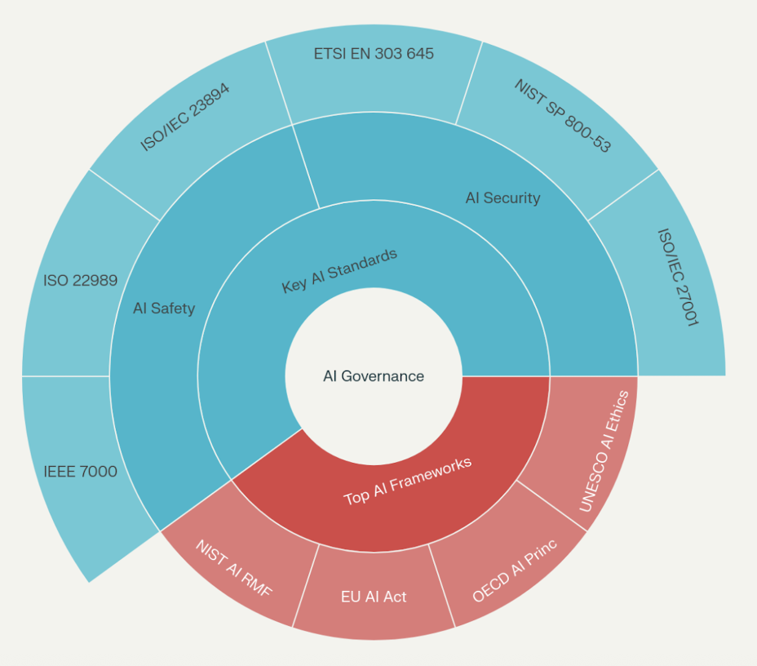
AI Governance Framework
Alexander Cyber Advisory
Notes:
Here is a table listing each of the top overarching AI frameworks and key AI standards organized by AI Security and AI Safety, with official source links for easy access:
| Name | Official Link |
|---|---|
| **NIST AI Risk Management Framework (AI RMF)** | [NIST AI RMF](https://www.nist.gov/itl/ai-risk-management-framework) [1] |
| **EU AI Act** | [EU AI Act Legal Text](https://ai-act-law.eu) [2] |
| **OECD AI Principles** | [OECD AI Principles](https://www.oecd.org/en/topics/sub-issues/ai-principles.html) [3] |
| **UNESCO AI Ethics Recommendation** | [UNESCO AI Ethics PDF](https://www.ohchr.org/sites/default/files/2022-03/UNESCO.pdf) [4] |
**AI Security Standards**
| Name | Official Link |
|---|---|
| ISO/IEC 27001 | [ISO/IEC 27001](https://en.wikipedia.org/wiki/ISO/IEC_27001) [5] |
| NIST SP 800-53 | [NIST SP 800-53](https://en.wikipedia.org/wiki/NIST_Special_Publication_800-53) [6] |
| ETSI EN 303 645 | [ETSI EN 303 645](https://docs.zephyrproject.org/latest/security/standards/etsi-303645.html) [7] |
**AI Safety Standards**
| Name | Official Link |
|---|---|
| ISO/IEC 23894 | [ISO/IEC 23894](https://stendard.com/en-sg/blog/iso-23894/) [8] |
| ISO 22989 | [ISO 22989 Info](https://www.iso.org/standard/74296.html) |
| IEEE 7000 | [IEEE 7000 Series](https://standards.ieee.org/ieee/7000/7885/) |
This provides direct references for learning more about each framework or standard.
Sources
[1] AI Risk Management Framework | NIST https://www.nist.gov/itl/ai-risk-management-framework
[2] AI Act as a neatly arranged website – Legal Text https://ai-act-law.eu
[3] AI principles - OECD https://www.oecd.org/en/topics/sub-issues/ai-principles.html
[4] [PDF] UNESCO Recommendation on the Ethics of Artificial Intelligence https://www.ohchr.org/sites/default/files/2022-03/UNESCO.pdf
[5] ISO/IEC 27001 - Wikipedia https://en.wikipedia.org/wiki/ISO/IEC_27001
[6] NIST Special Publication 800-53 - Wikipedia https://en.wikipedia.org/wiki/NIST_Special_Publication_800-53
[7] ETSI 303-645 - Zephyr Project Documentation https://docs.zephyrproject.org/latest/security/standards/etsi-303645.html
[8] ISO 23894 Explained: AI Risk Management Made Simple - Stendard https://stendard.com/en-sg/blog/iso-23894/
[9] AI RMF - AIRC - NIST AI Resource Center https://airc.nist.gov/airmf-resources/airmf/
[10] [PDF] Artificial Intelligence Risk Management Framework (AI RMF 1.0) https://nvlpubs.nist.gov/nistpubs/ai/nist.ai.100-1.pdf
[11] Introduction to the NIST AI Risk Management Framework (AI RMF 1.0) https://www.nist.gov/video/introduction-nist-ai-risk-management-framework-ai-rmf-10-explainer-video
[12] NIST AI Risk Management Framework (AI RMF) - Palo Alto Networks https://www.paloaltonetworks.com/cyberpedia/nist-ai-risk-management-framework
[13] Artificial Intelligence Act - Wikipedia https://en.wikipedia.org/wiki/Artificial_Intelligence_Act
[14] NIST SP 800-53 Compliance | Improve Your Security System https://hyperproof.io/nist-800-53/
[15] Guide to ETSI EN 303 645 Compliance Services - UL Solutions https://www.ul.com/resources/guide-etsi-en-303-645-compliance-services
[16] Navigating the NIST AI Risk Management Framework - Hyperproof https://hyperproof.io/navigating-the-nist-ai-risk-management-framework/
[17] OECD Updates AI Principles - American National Standards Institute https://www.ansi.org/standards-news/all-news/5-9-24-oecd-updates-ai-principles
[18] Principles for the Ethical Use of Artificial Intelligence in the United ... https://unsceb.org/principles-ethical-use-artificial-intelligence-united-nations-system
[19] ISO/IEC 27001 International Standard - TrustArc https://trustarc.com/regulations/iso-iec-27001/

Slide 21
Additional Resources
Overarching Frameworks | AI Standards | AI Security | AI Safety
NIST AI Risk Management Framework (AI RMF) | ISO/IEC 42001 Artificial Intelligence Management System | ISO/IEC 27090 - specifically on AI security is still in draft status and due for final publication in late 2025 | OECD’s (Organization for Economic Co-operation and Development) AI Principles and Ethical OS Toolkit
EU AI Act | Cloud Security Alliance AI Controls Matrix (CSA AICM) | OWASP AI Security & Privacy Guide and OWASP GenAI Security Project | IEEE Ethically Aligned Design
Google Secure AI Framework (SAIF) | ISO/IEC 22989 AI Terminology | SANS Critical AI Security Guidelines on Github | UNESCO AI Ethics Recommendations
Microsoft AI Governance Model | ISO/IEC 24028 AI Security Standards | MITRE ATLAS (Adversarial Threat Landscape for Artificial-Intelligence Systems) Framework | Partnership for AI Safety (PIA): Safe Foundation Model Deployment and Responsible Practices for Synthetic Media
 |  | AI Incident Database
Alexander Cyber Advisory
Notes:
Overarching Frameworks
Standards
AI Security
AI Safety
NIST AI Risk Management Framework (AI RMF): Provides organizations with a structured, flexible, and voluntary approach for identifying, measuring, managing, and governing risks across the entire AI lifecycle—from design to deployment to monitoring.
ISO/EIC 42001 Artificial Intelligence Management System
ISO/EIC 27090 - specifically on AI security is still in draft status and due for final publication in late 2025
EU AI Act: Risk-based regulatory framework categorizing AI systems as unacceptable, high, or limited risk.
Cloud Security Alliance AI Controls Matrix (CSA AICM)

Slide 22

Closing with a word to the wise…
The basics are there & align with Cyber & Privacy
Additional aspects of Safety, take Privacy one step further
Resources available
Governance is key
Focus, focus, focus to battle info overload
Alexander Cyber Advisory

Slide 23
Thank you!
Candy Alexander, CISSP CISM
Alexander Advisory Services
Candy@Alexander-Advisory.com

